Slide 1
KRISHKAM EXPORTS WOMENSWEAR
WESTERN & ETHNIC

Slide 2
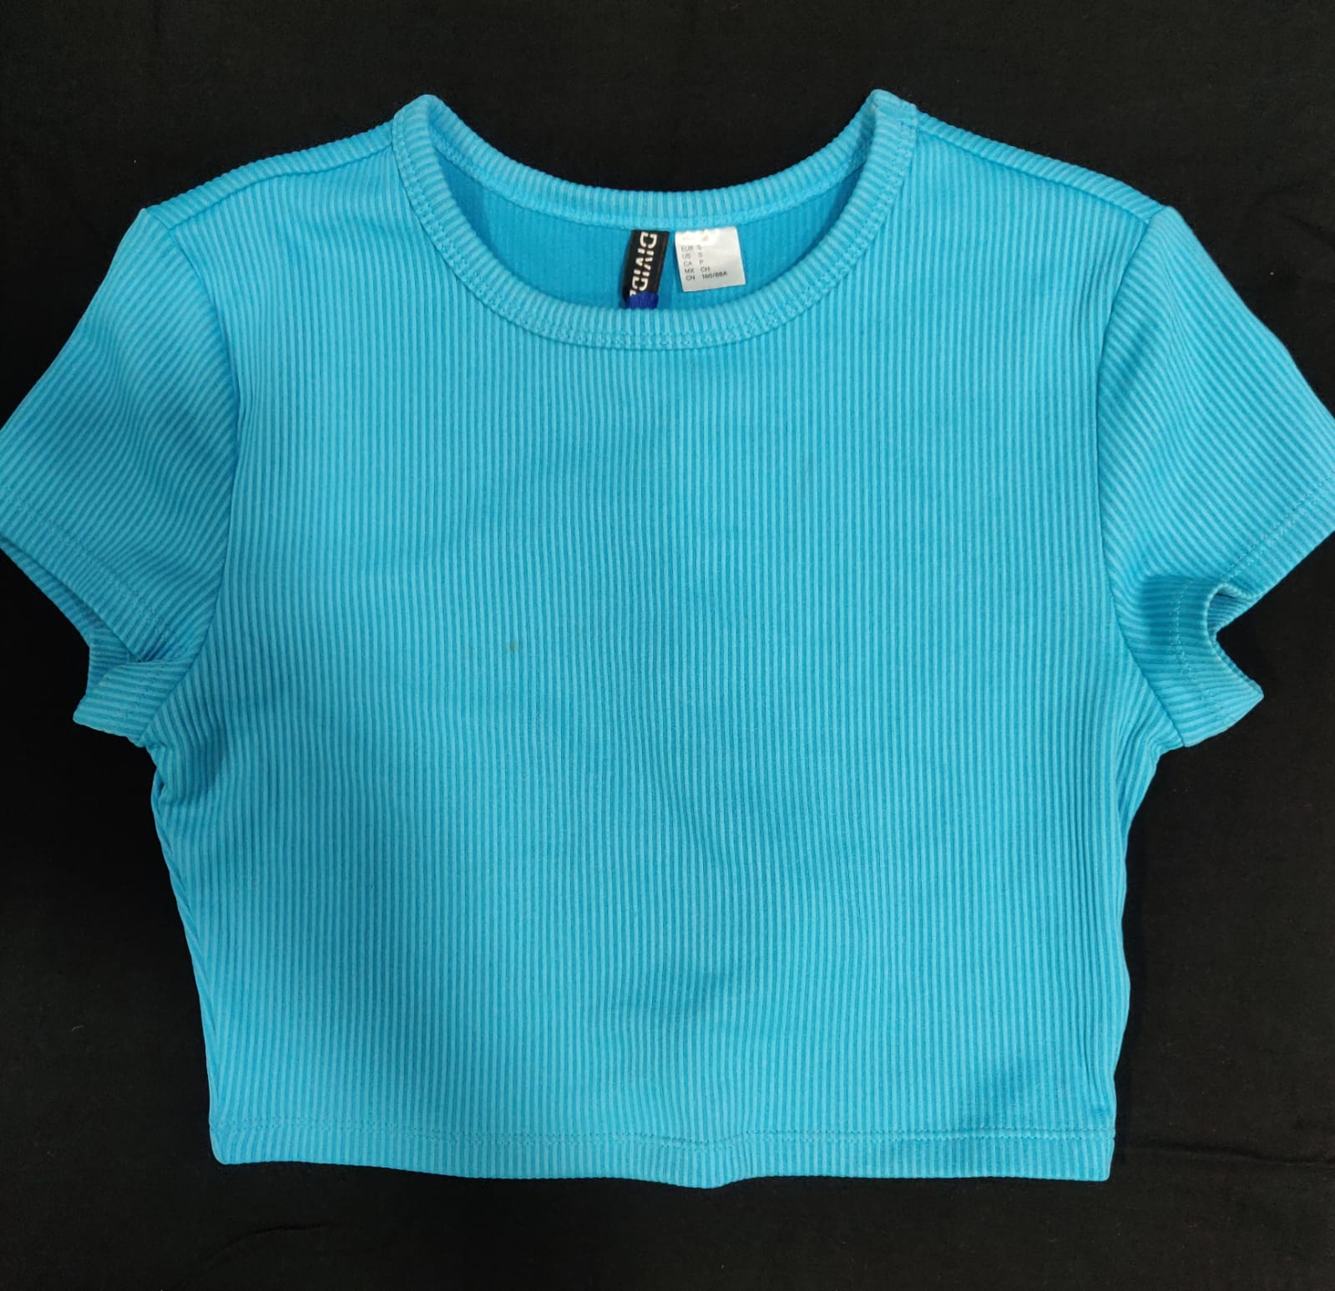
WOMENS CROP TOPS
Style number | KE-001
Product Description | Knit crop tee
Fabric Details | 65% Cotton 35% Poly s/j 140 GSM

Slide 3
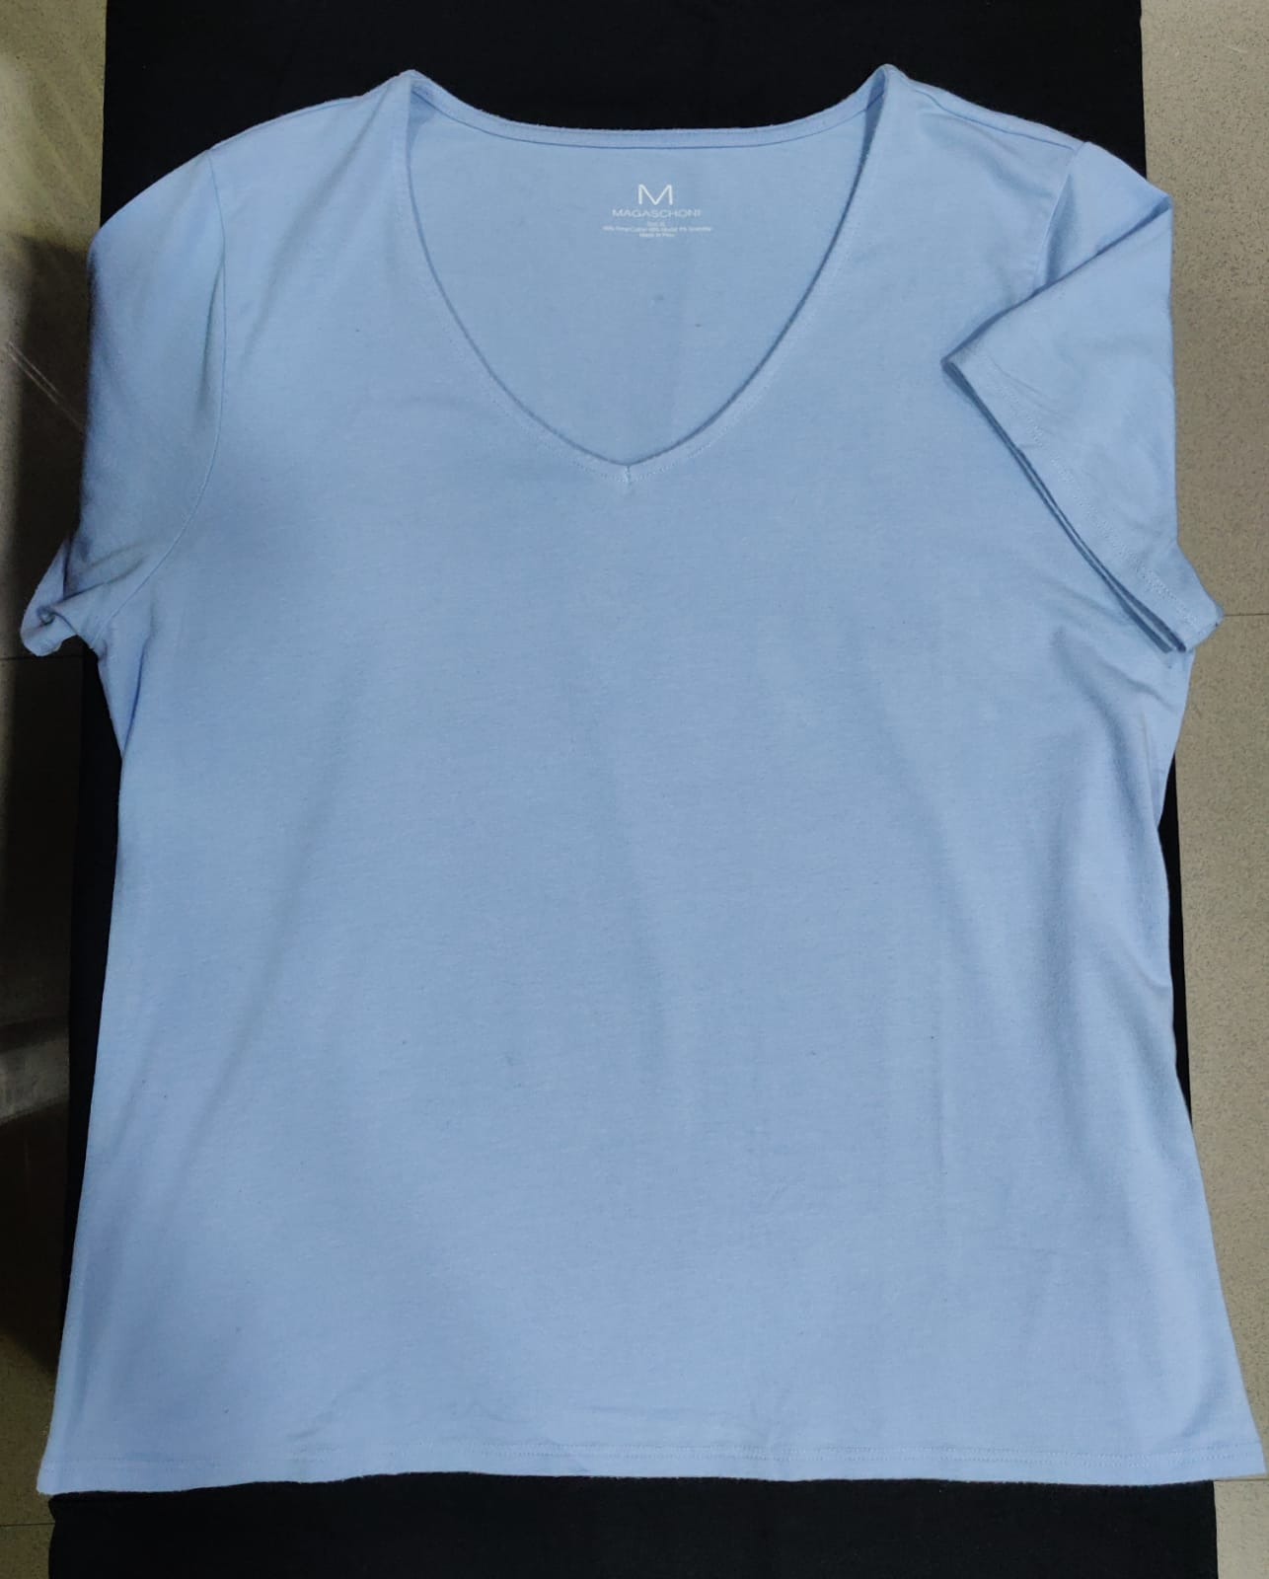
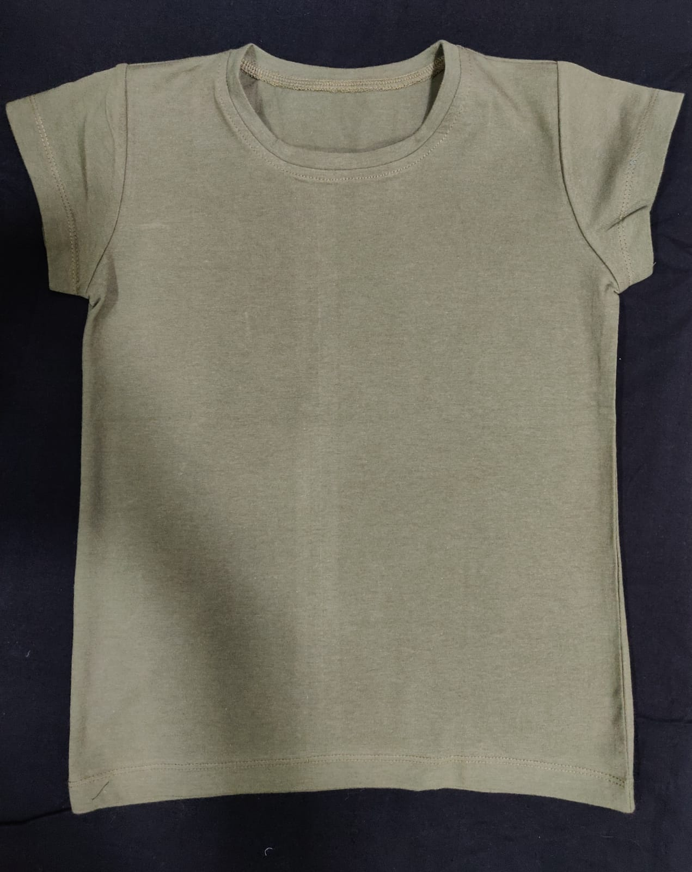
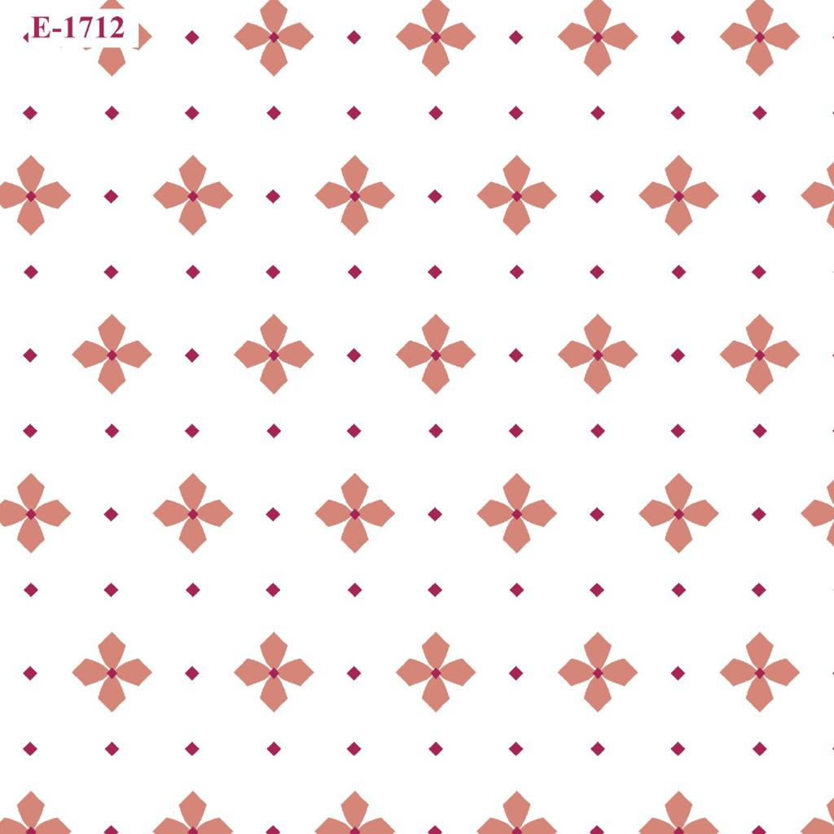
WOMENS TOPS
Style number | KE-002
Product Description | V-neck tee
Fabric Details | 65% Cotton 35% Poly s/j 140 GSM
Style number | KE-003
Product Description | Crew neck tee
Fabric Details | 65% Cotton 35% Poly s/j 140 GSM

Slide 4
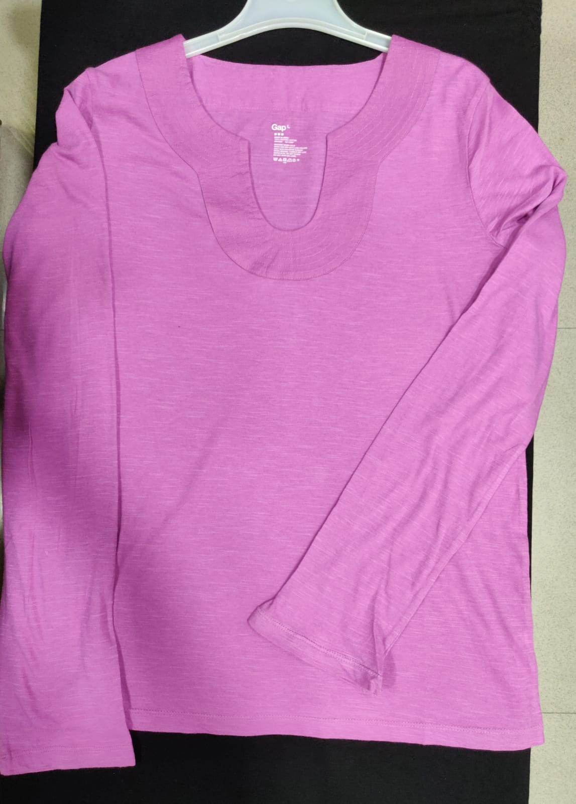
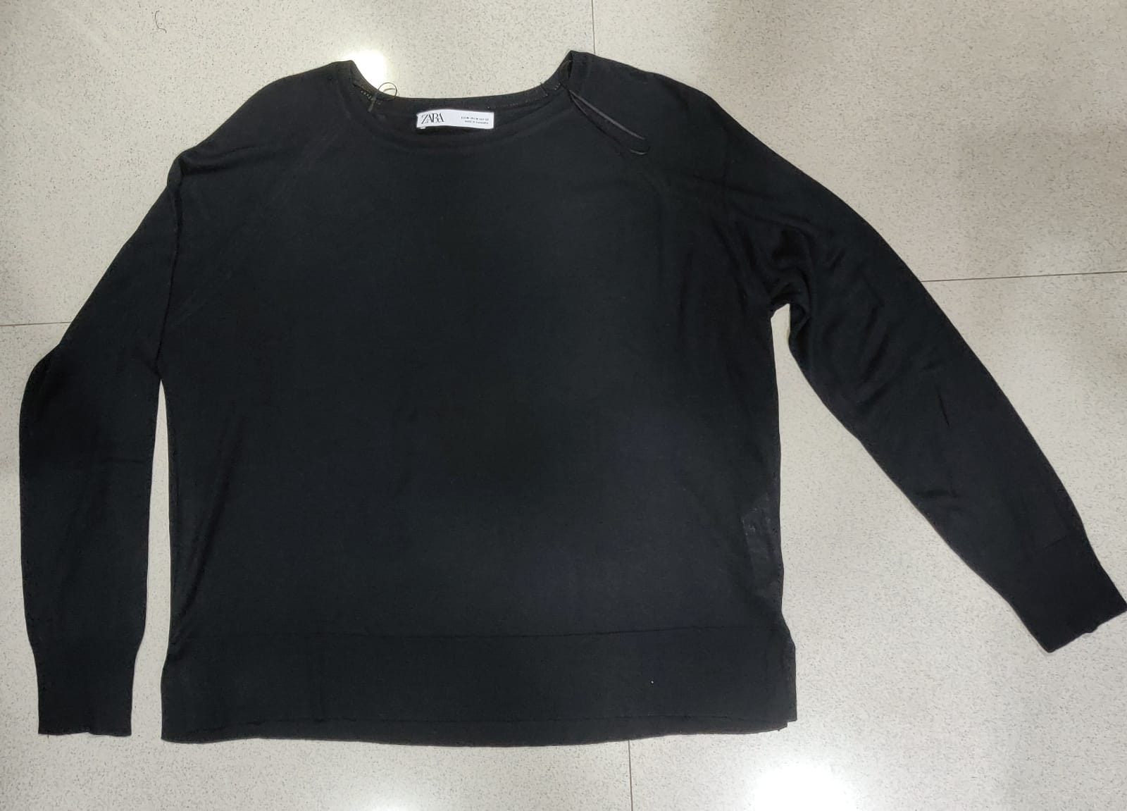
WOMENS TOPS
Style number | KE-004
Product Description | Long sleeve crew neck tee
Fabric Details | 65% Cotton 35% Poly s/j 140 GSM
Style number | KE-005
Product Description | Changed to V-neck tee
Fabric Details | 65% Cotton 35% Poly s/j 140 GSM

Slide 5
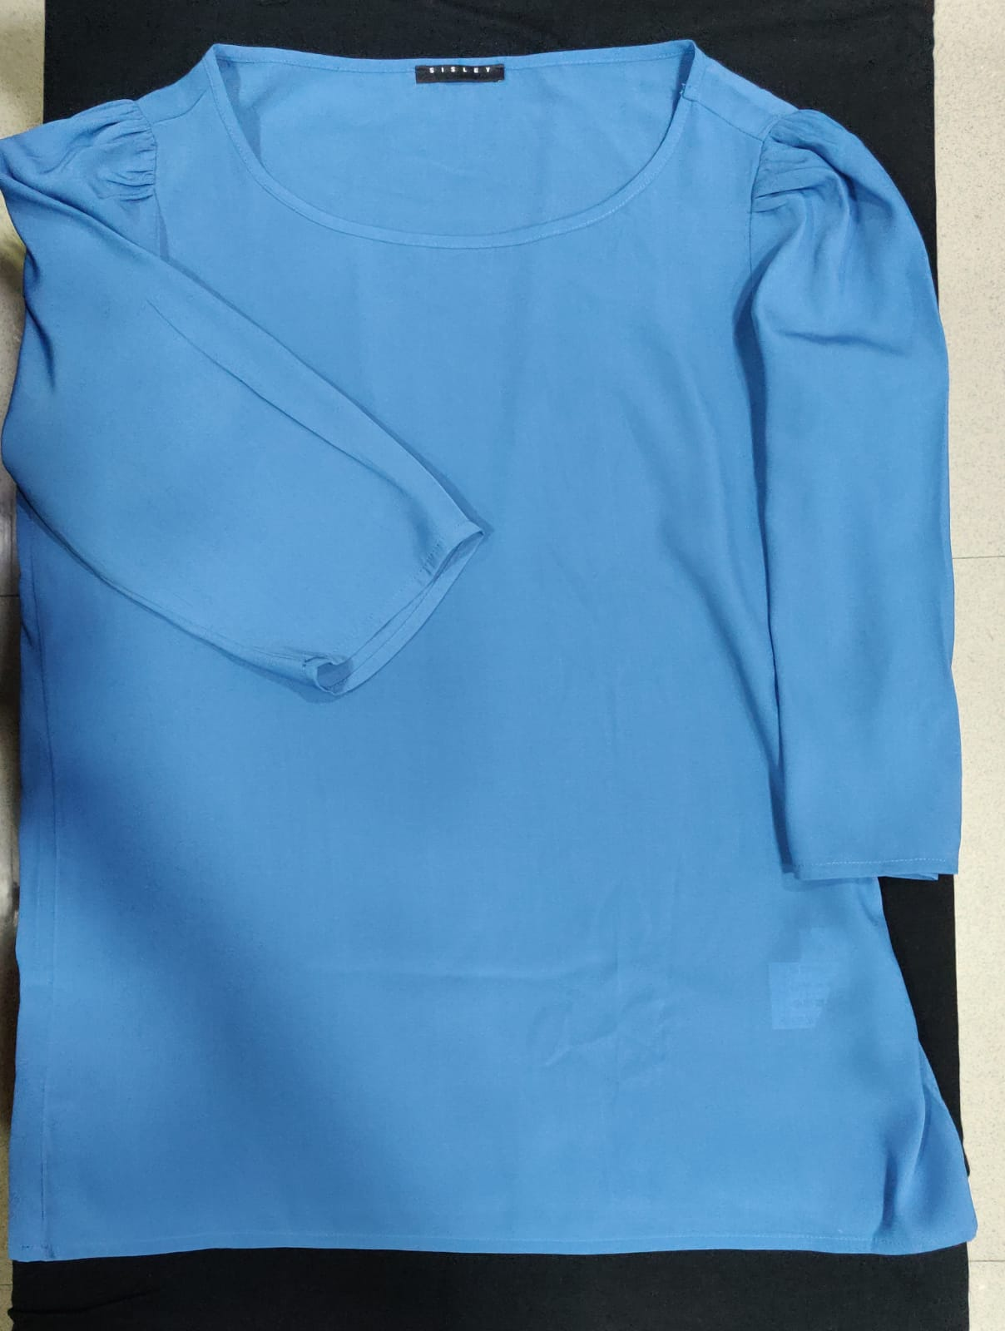
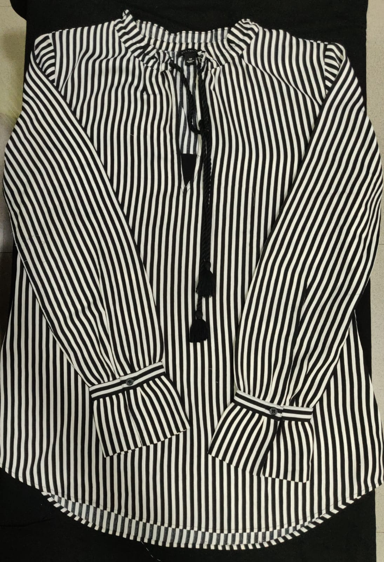
WOMENS TOPS
Style number | KE-006
Product Description | Puff sleeve blouse
Fabric Details | 100% polyester
Style number | KE-007
Product Description | Tassel blouse
Fabric Details | 100% viscose

Slide 6
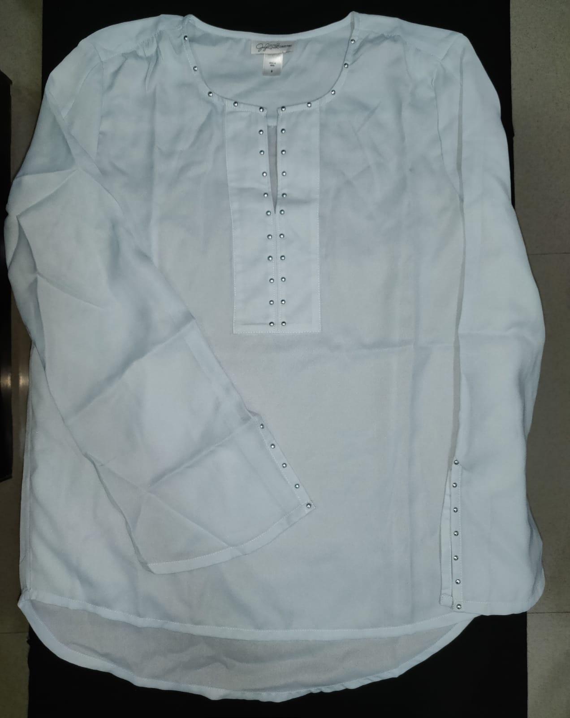
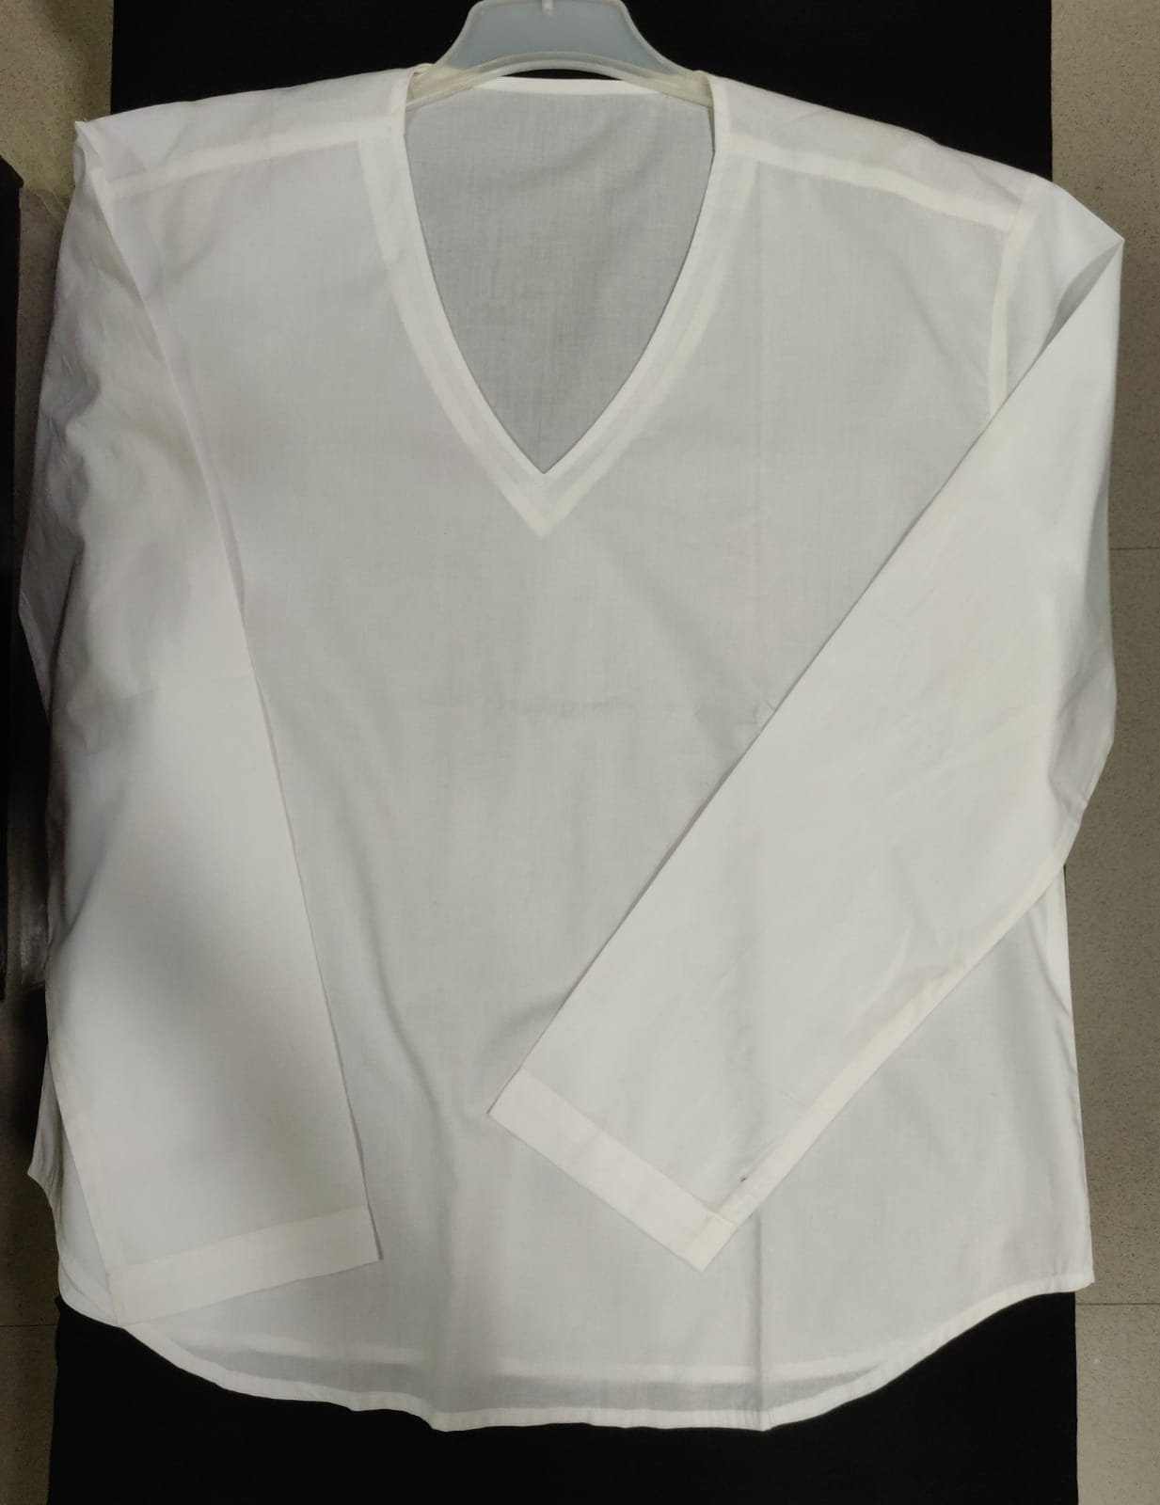
WOMENS TOPS
Style number | KE-008
Product Description | Long sleeve with studs
Fabric Details | 100% viscose
Style number | KE-009
Product Description | V-neck solid blouse
Fabric Details | 70% cotton 30% polyester

Slide 7
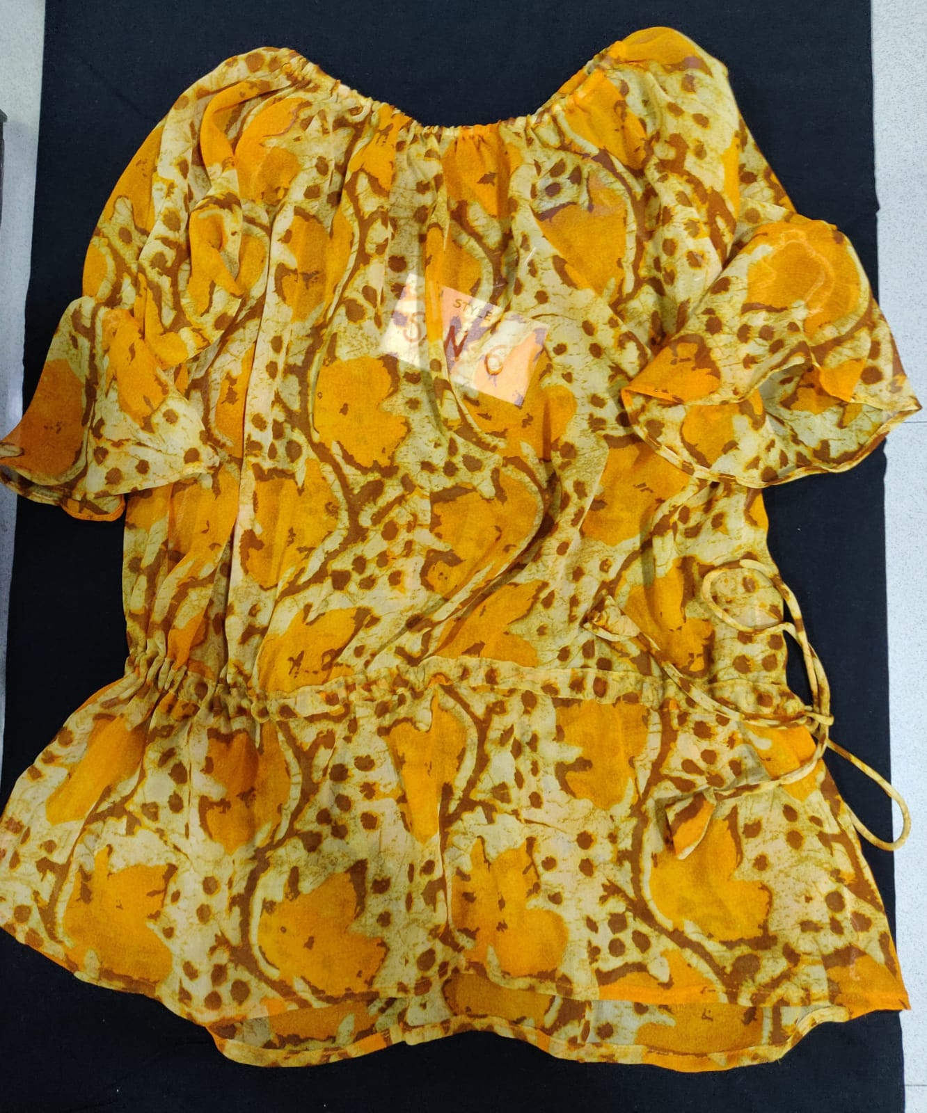
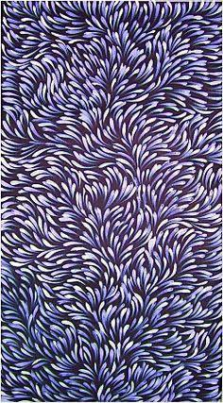
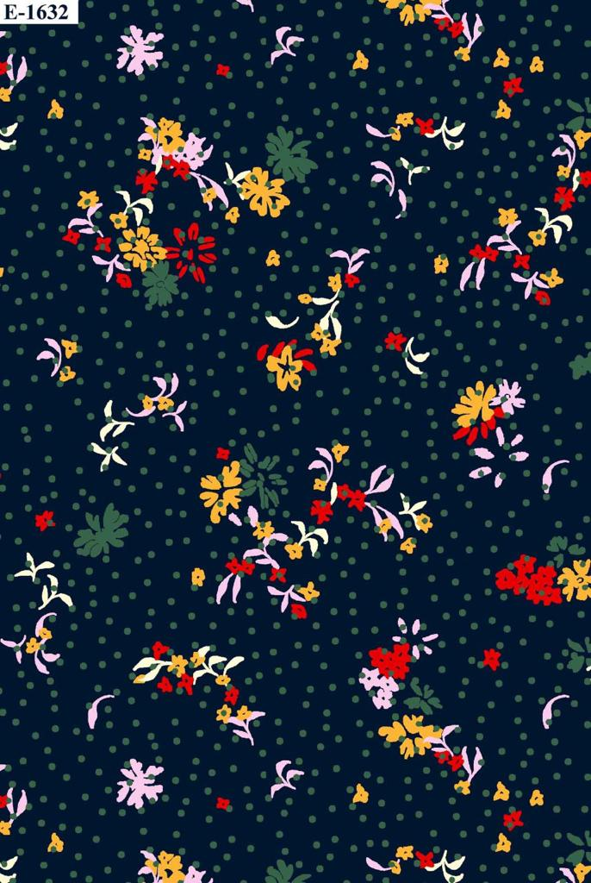
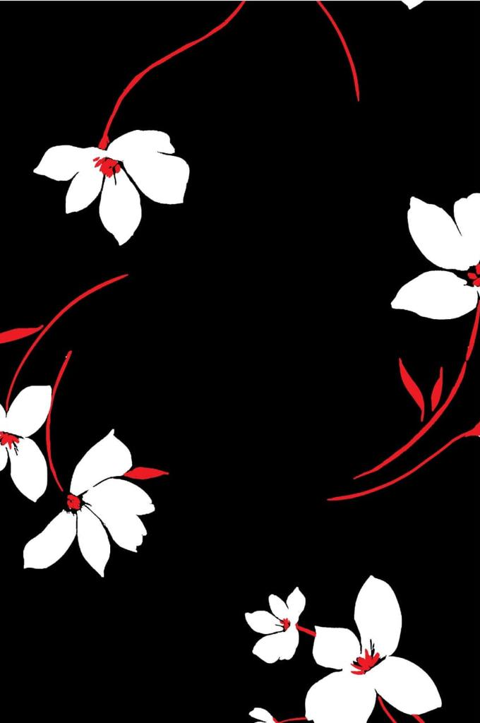
WOMENS TOPS
Style number | KE-010
Product Description | Gathered waist blouse
Fabric Details | 100% polyester

Slide 8
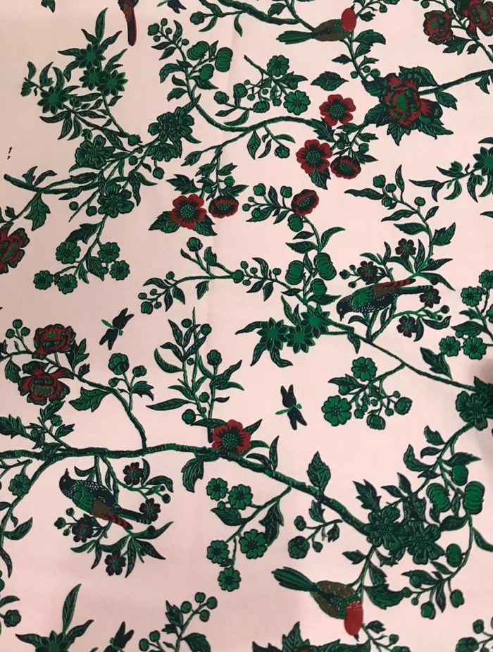
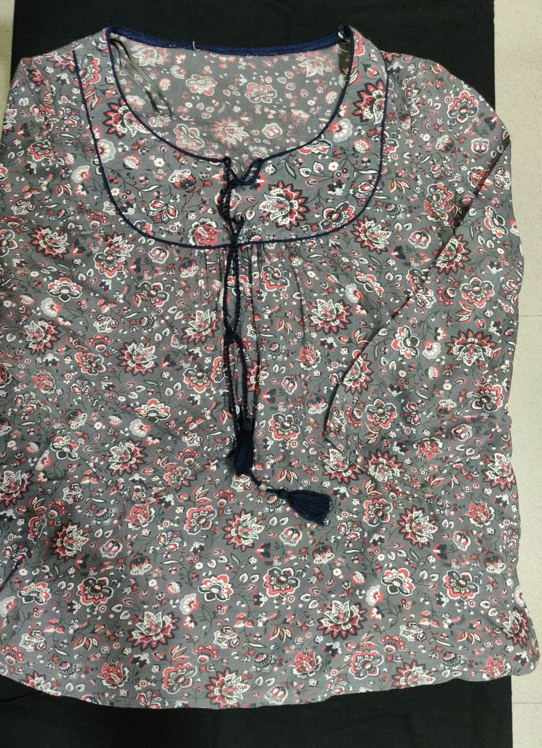
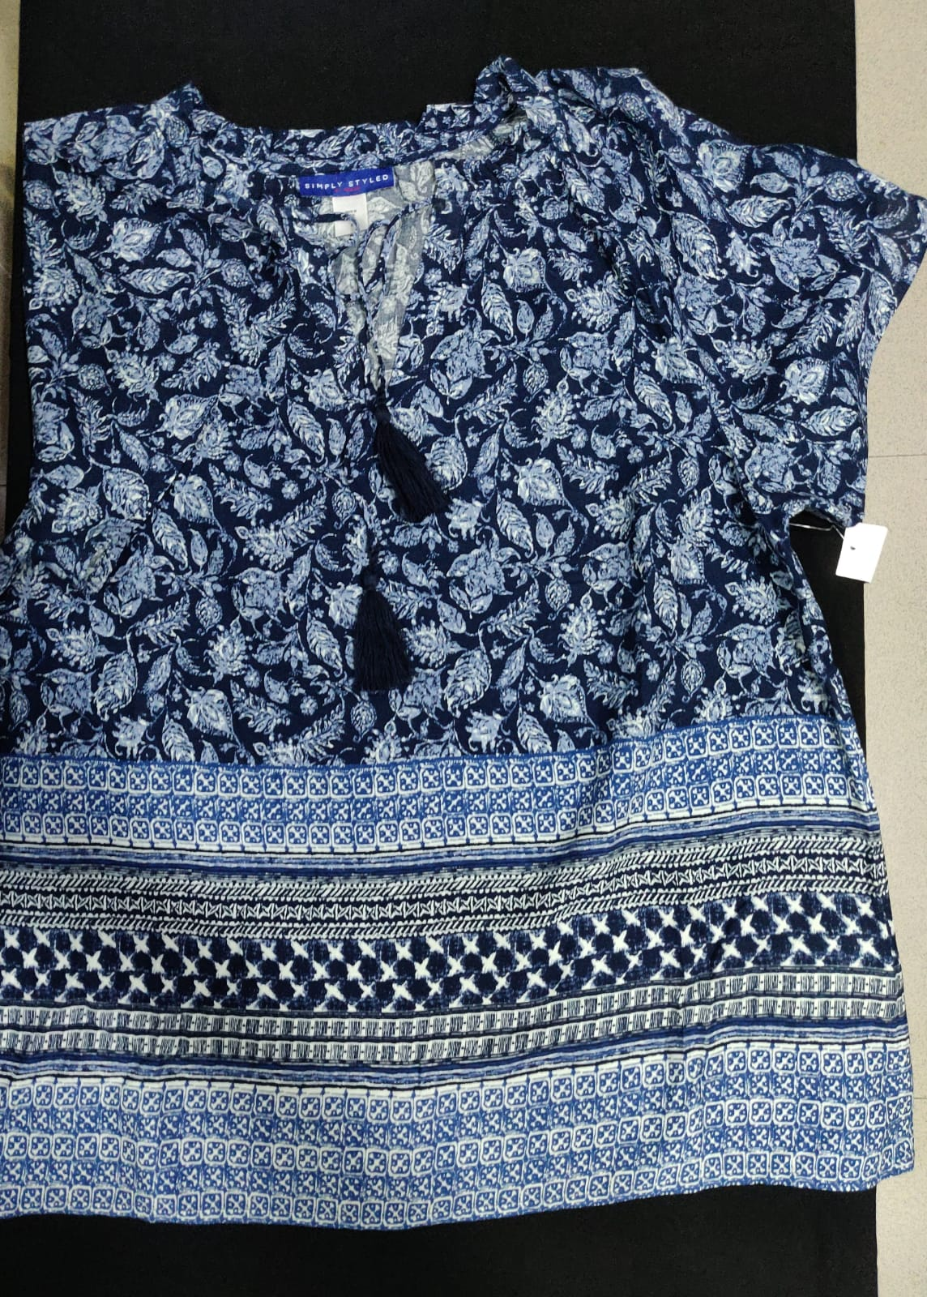
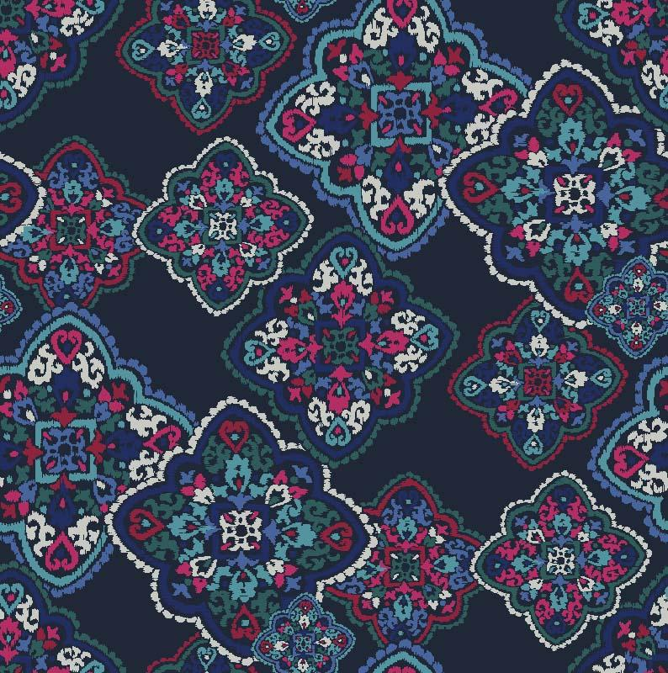
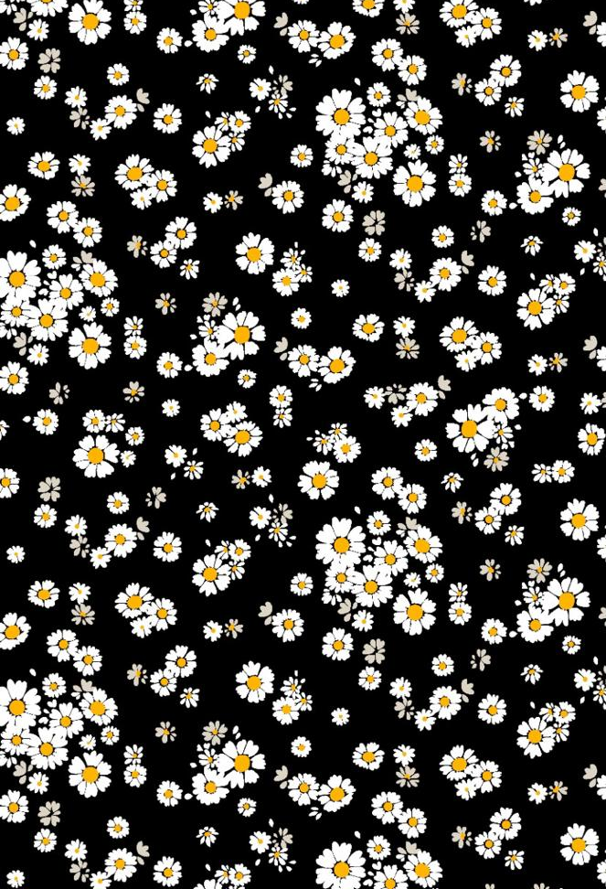
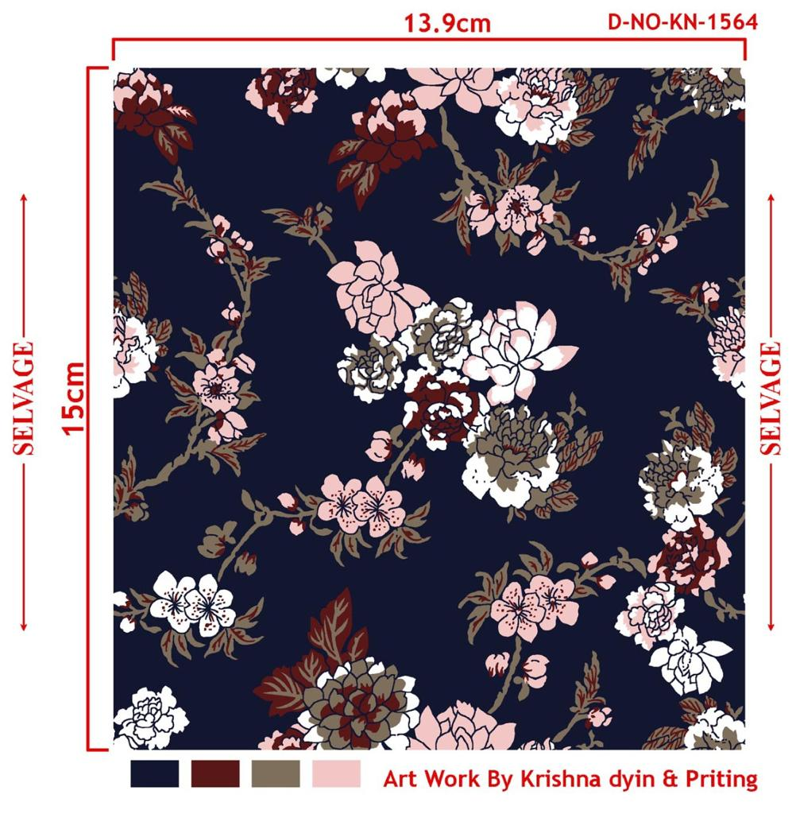
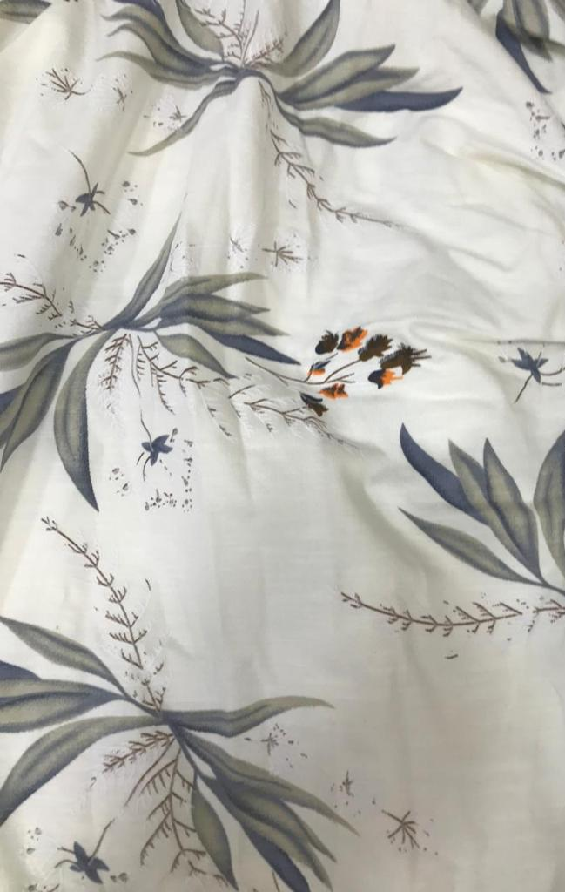
WOMENS TOPS
Style number | KE-011
Product Description | Tassel l/s blouse
Fabric Details | 100% viscose
Style number | KE-012
Product Description | Tassel h/s blouse AOP
Fabric Details | 100% viscose

Slide 9
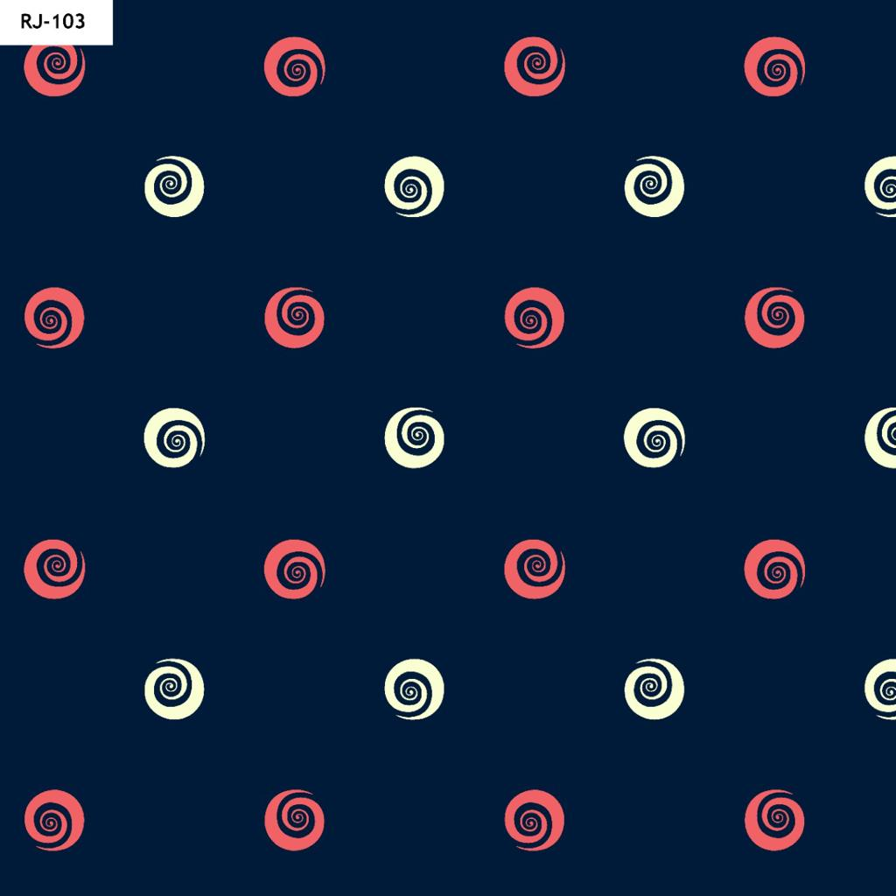
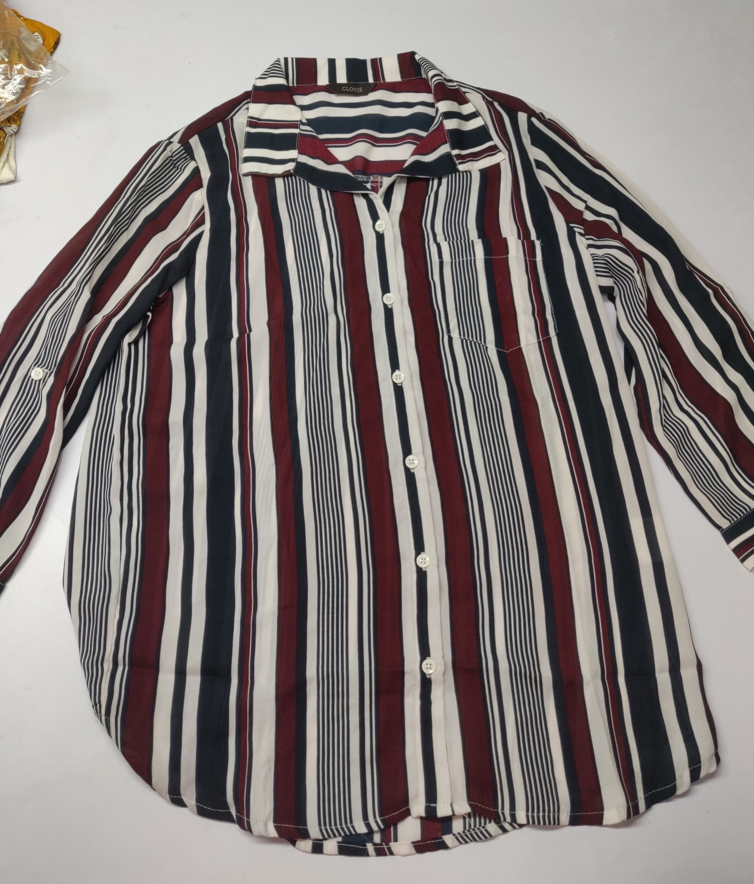
WOMENS SHIRTS
Style number | KE-013
Product Description | Womens shirt printed
Fabric Details | 100% polyester

Slide 10
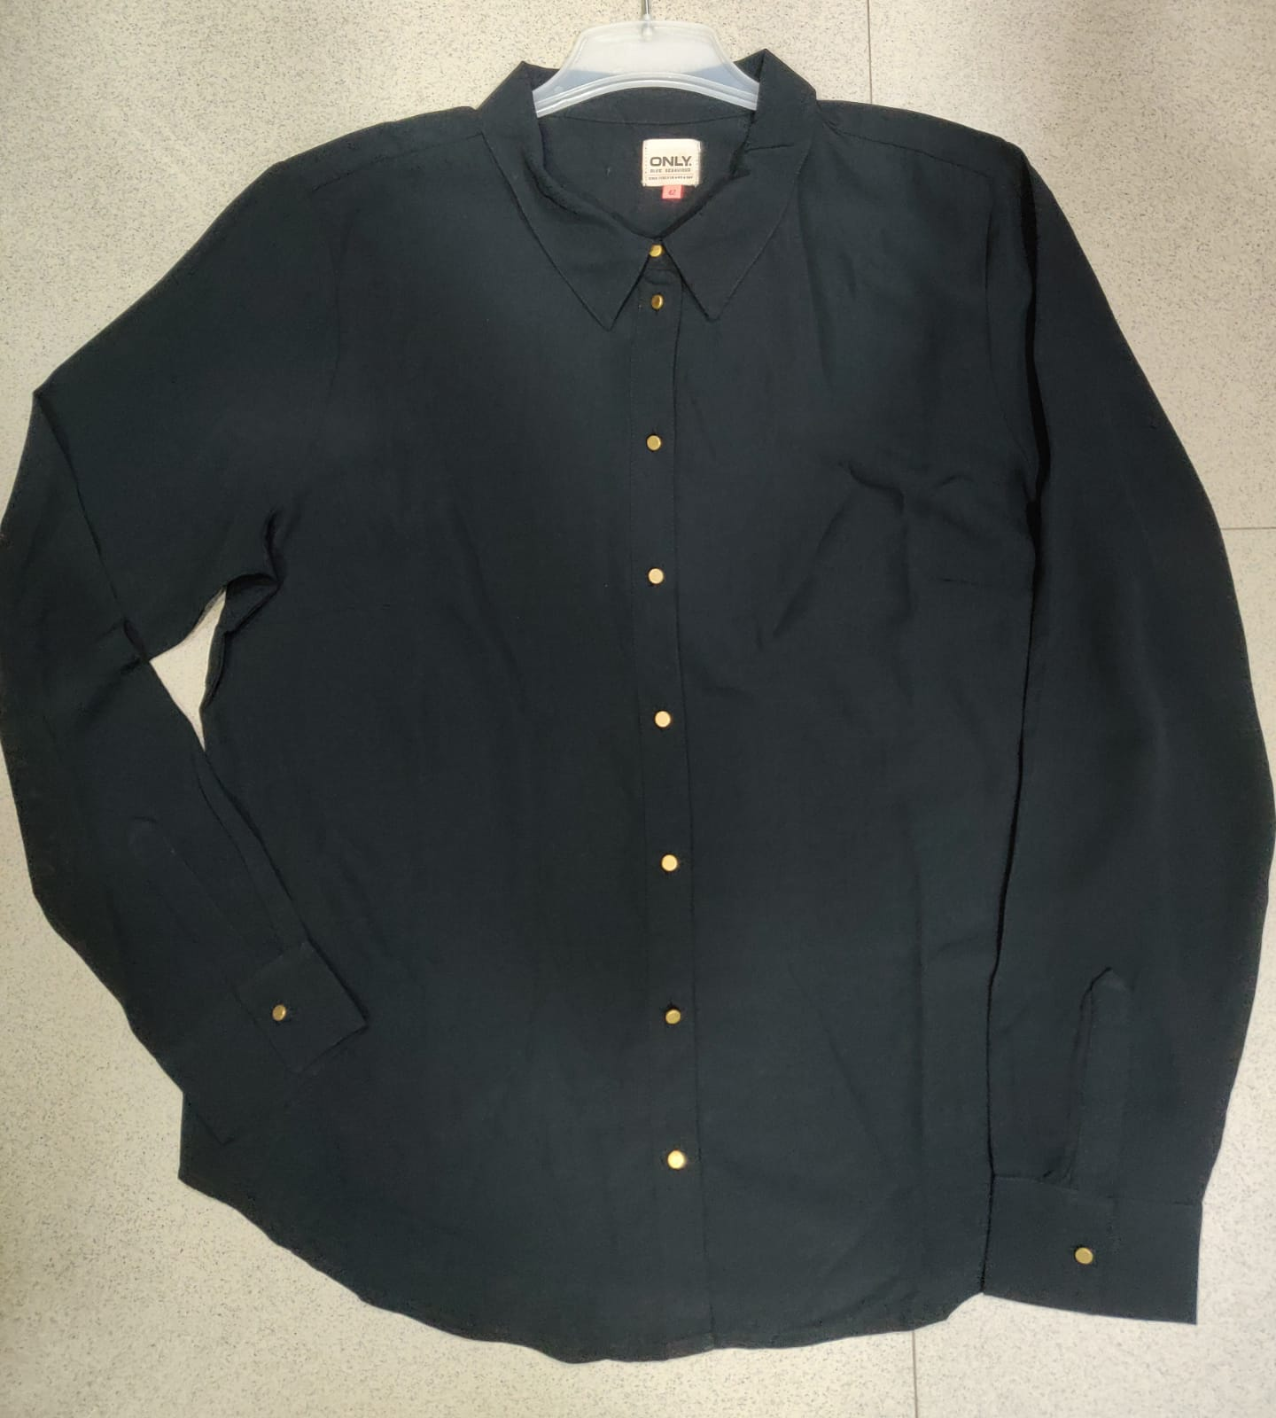
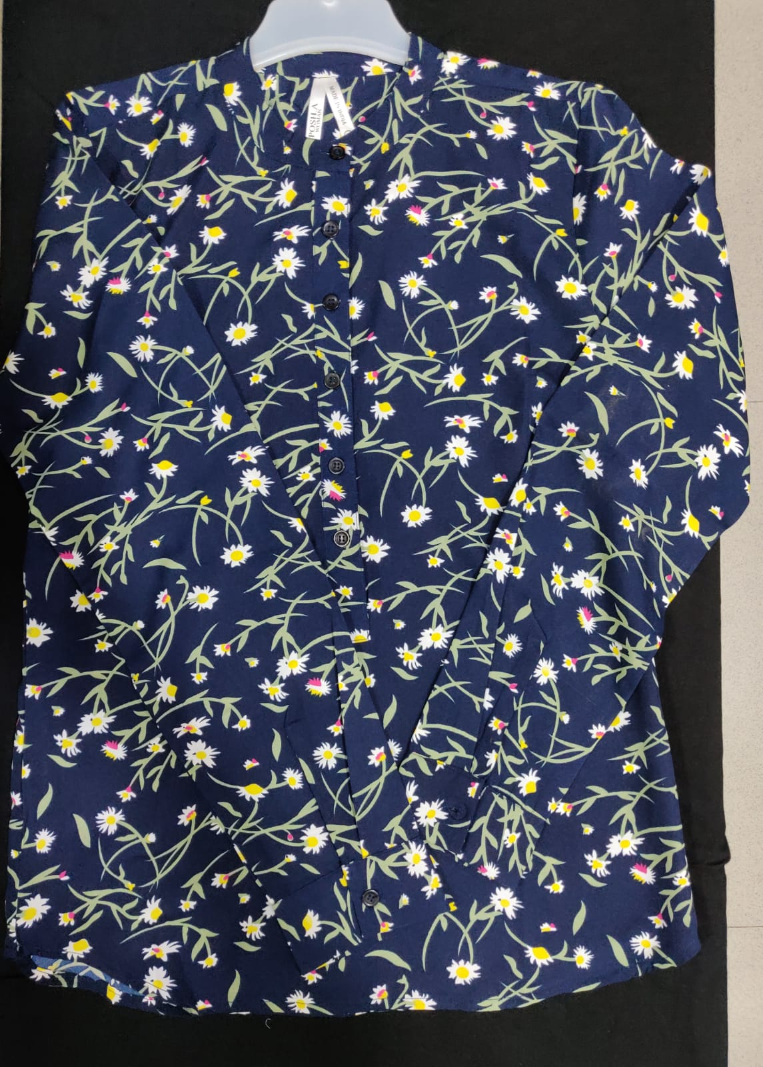
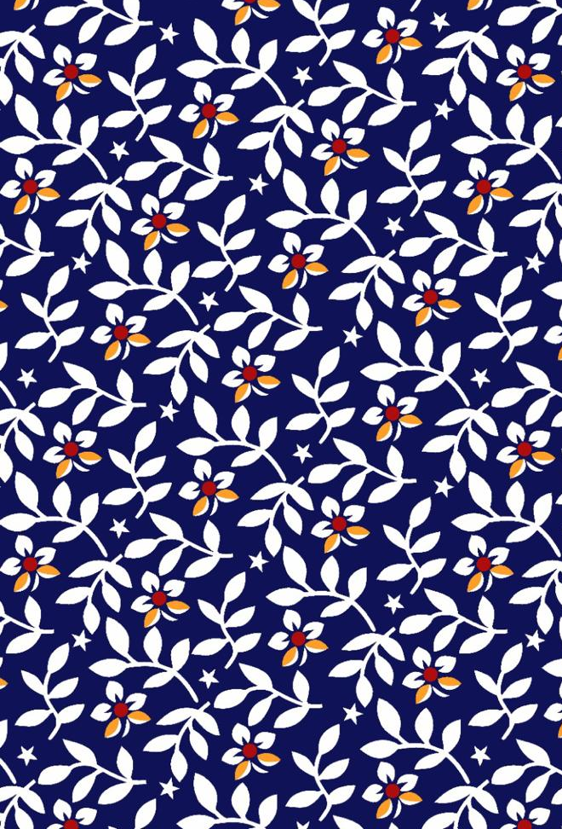
WOMENS SHIRTS
Style number | KE-014
Product Description | Womens shirt solid
Fabric Details | 100% polyester
Style number | KE-015
Product Description | Womens shirt printed
Fabric Details | 100% viscose

Slide 11
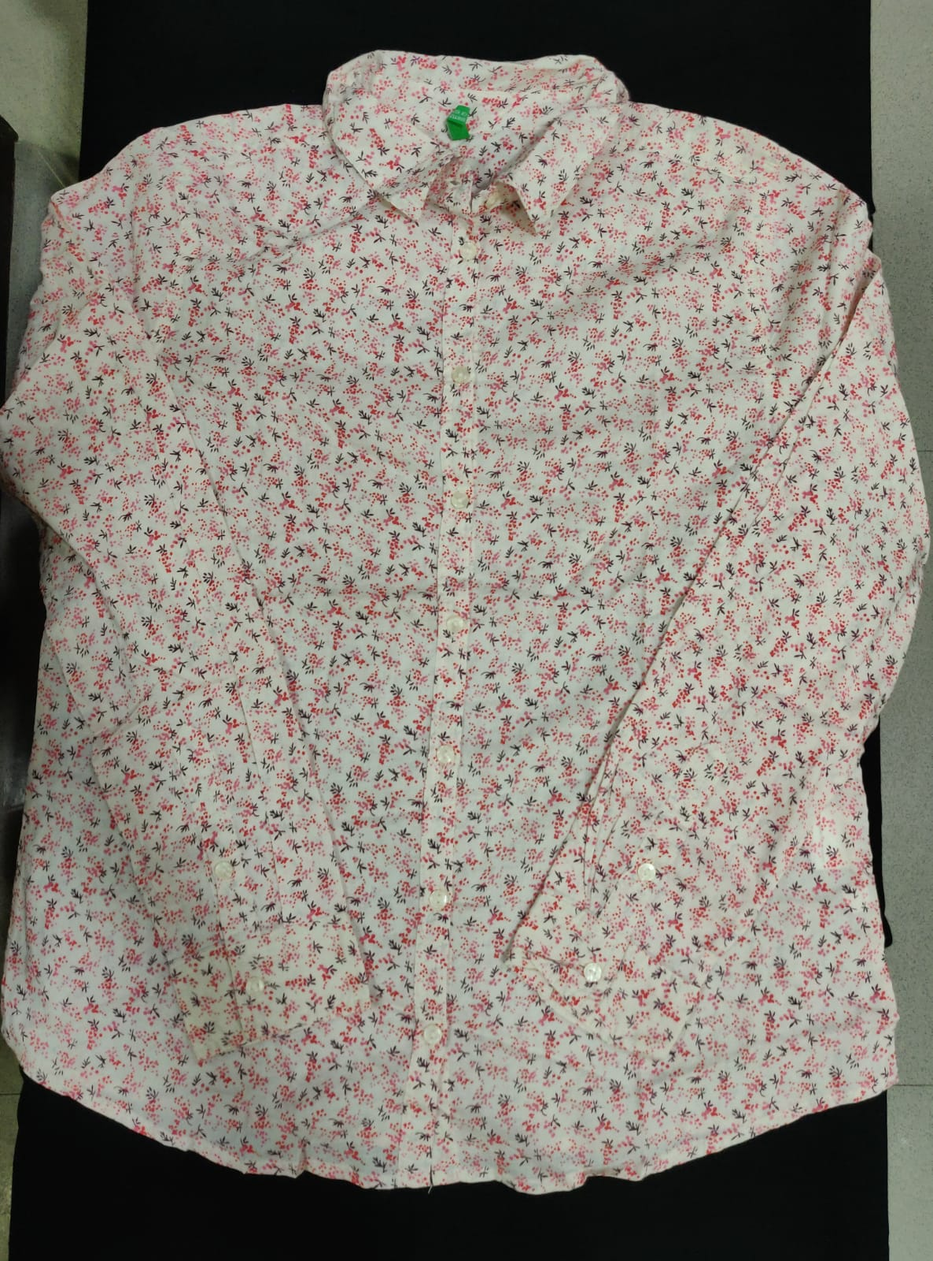
WOMENS SHIRTS
Style number | KE-016
Product Description | Womens shirt
Fabric Details | 100% viscose

Slide 12
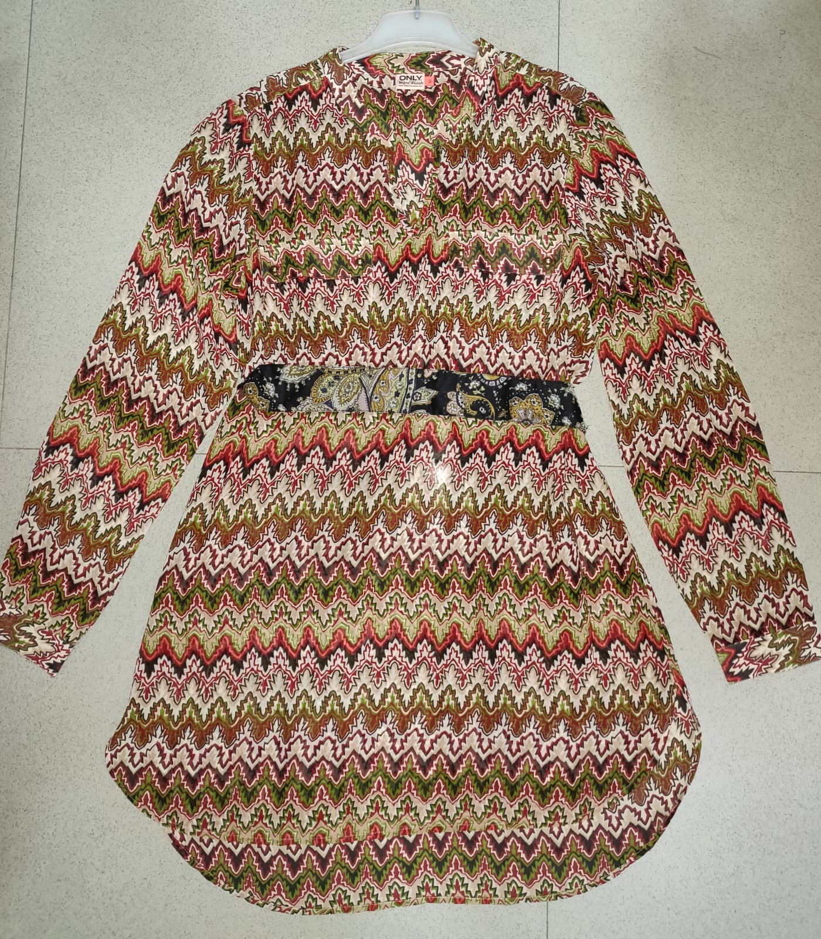
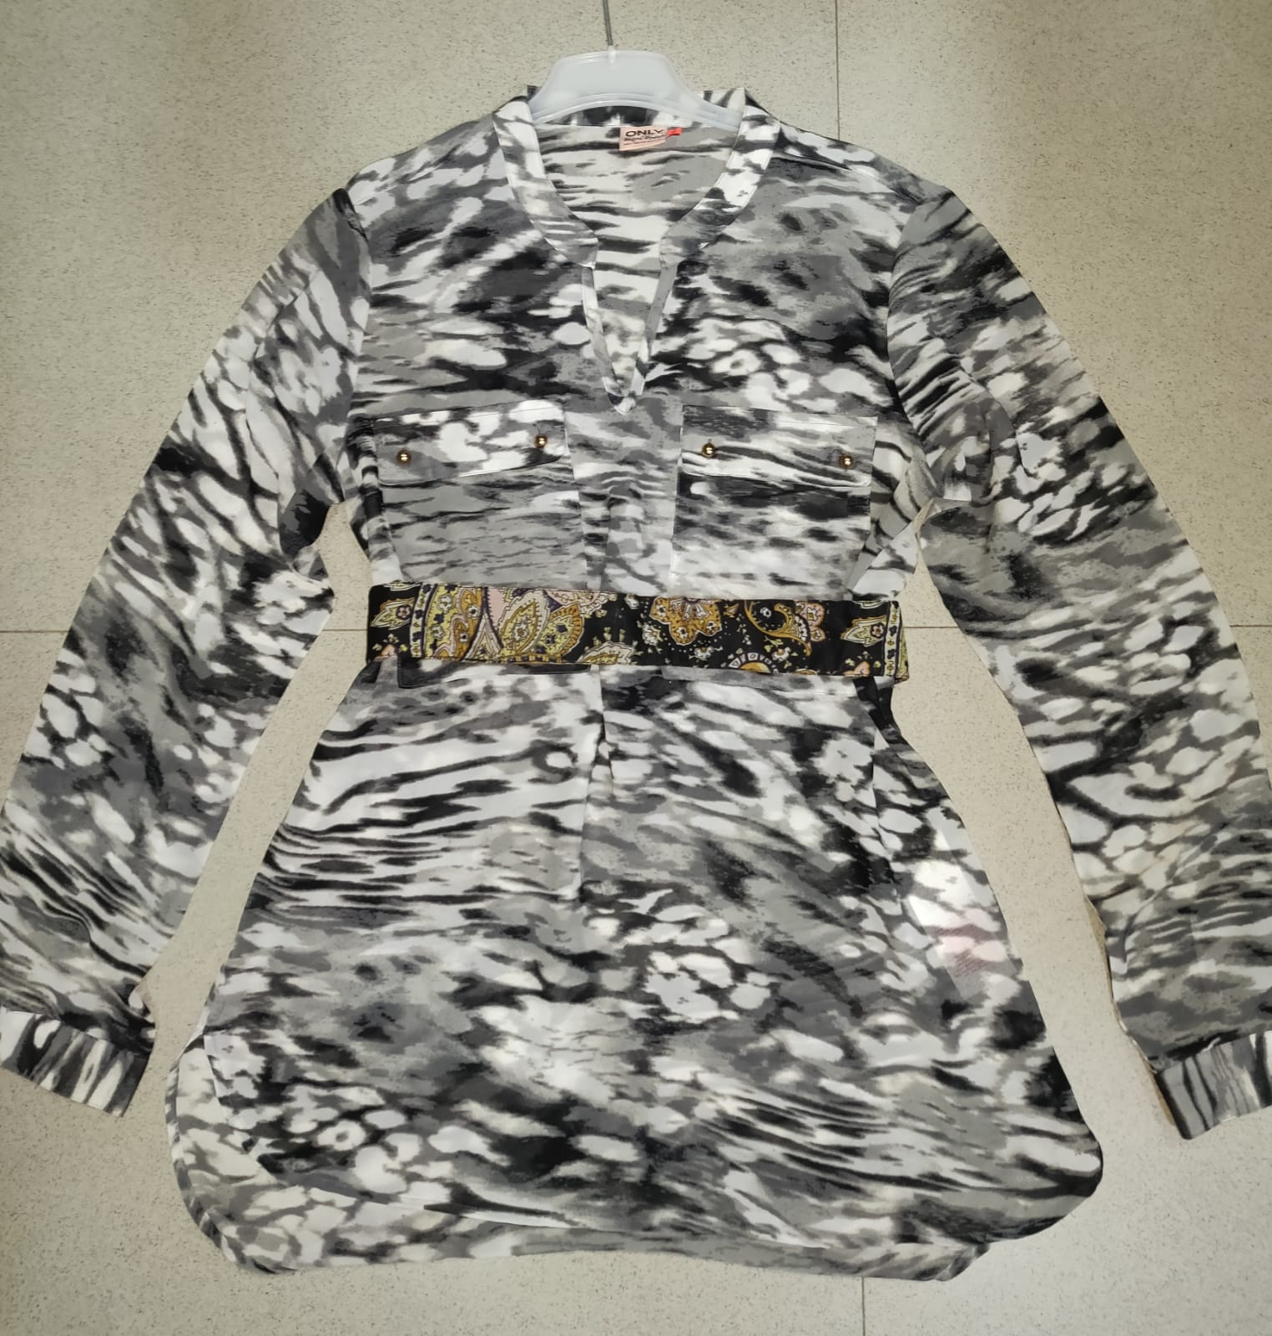
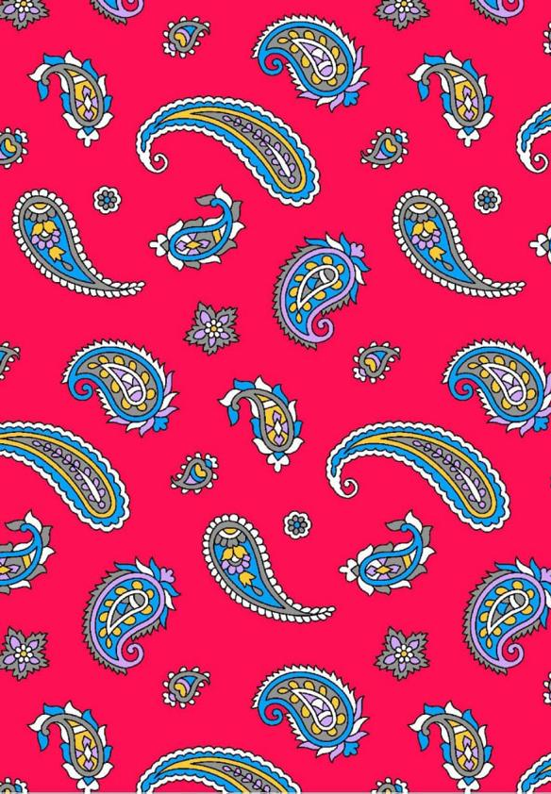
WOMENS TOPS
Style number | KE-017
Product Description | Belt dress
Fabric Details | 100% polyester
Comments : Belt in contrast color fabric

Slide 13
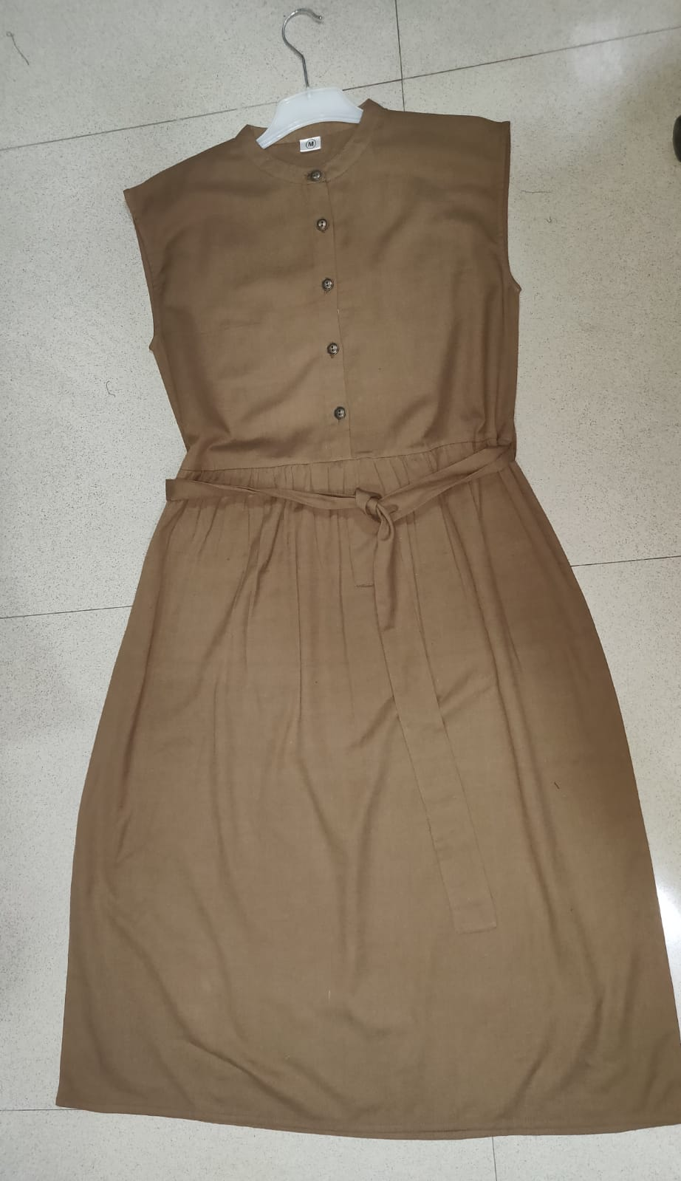
WOMENS DRESSES
Style number | KE-018
Product Description | Button dress
Fabric Details | 100% viscose

Slide 14
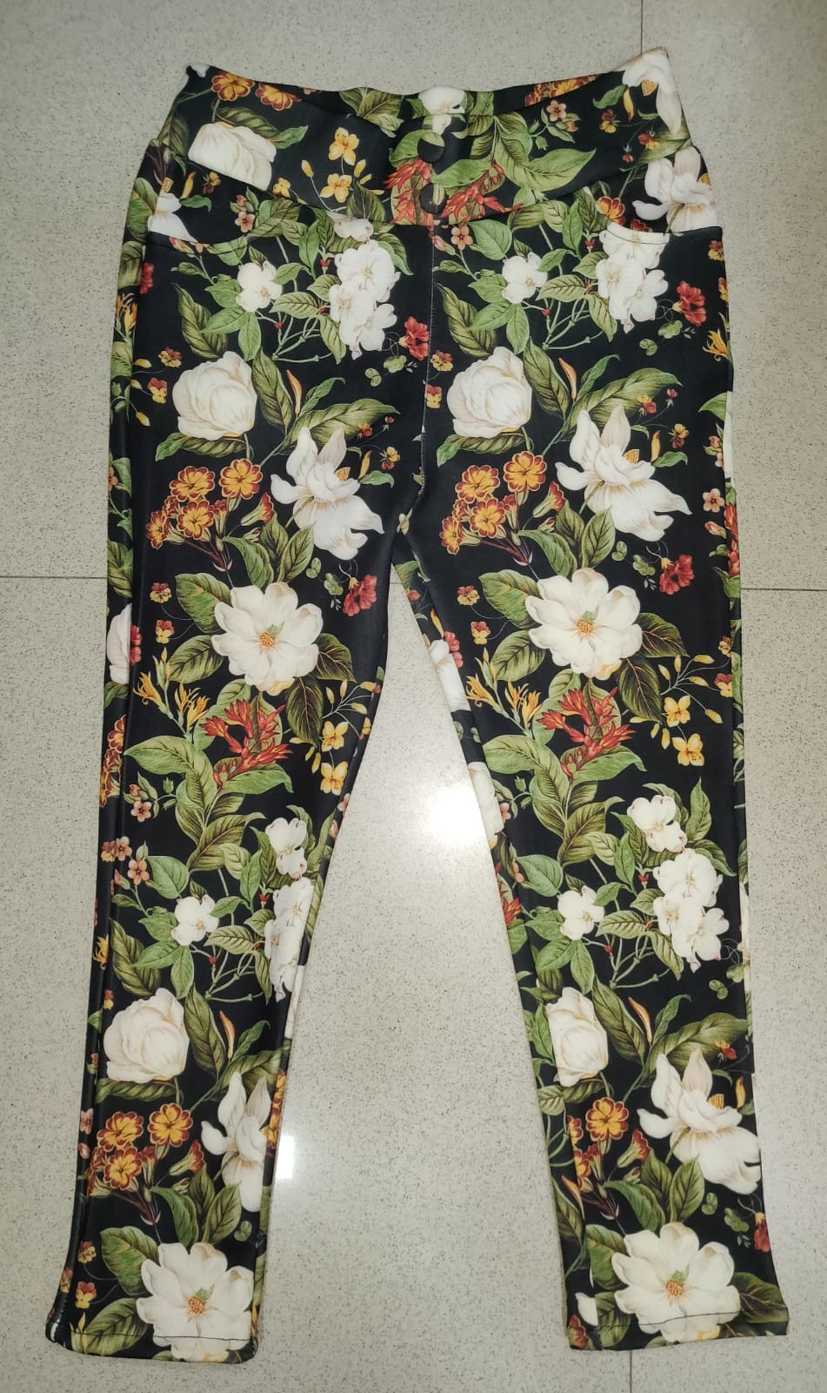
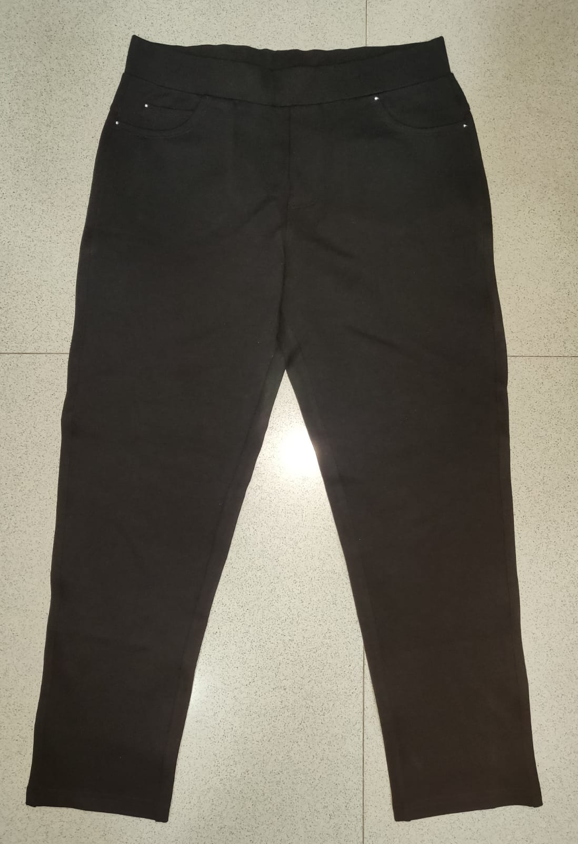
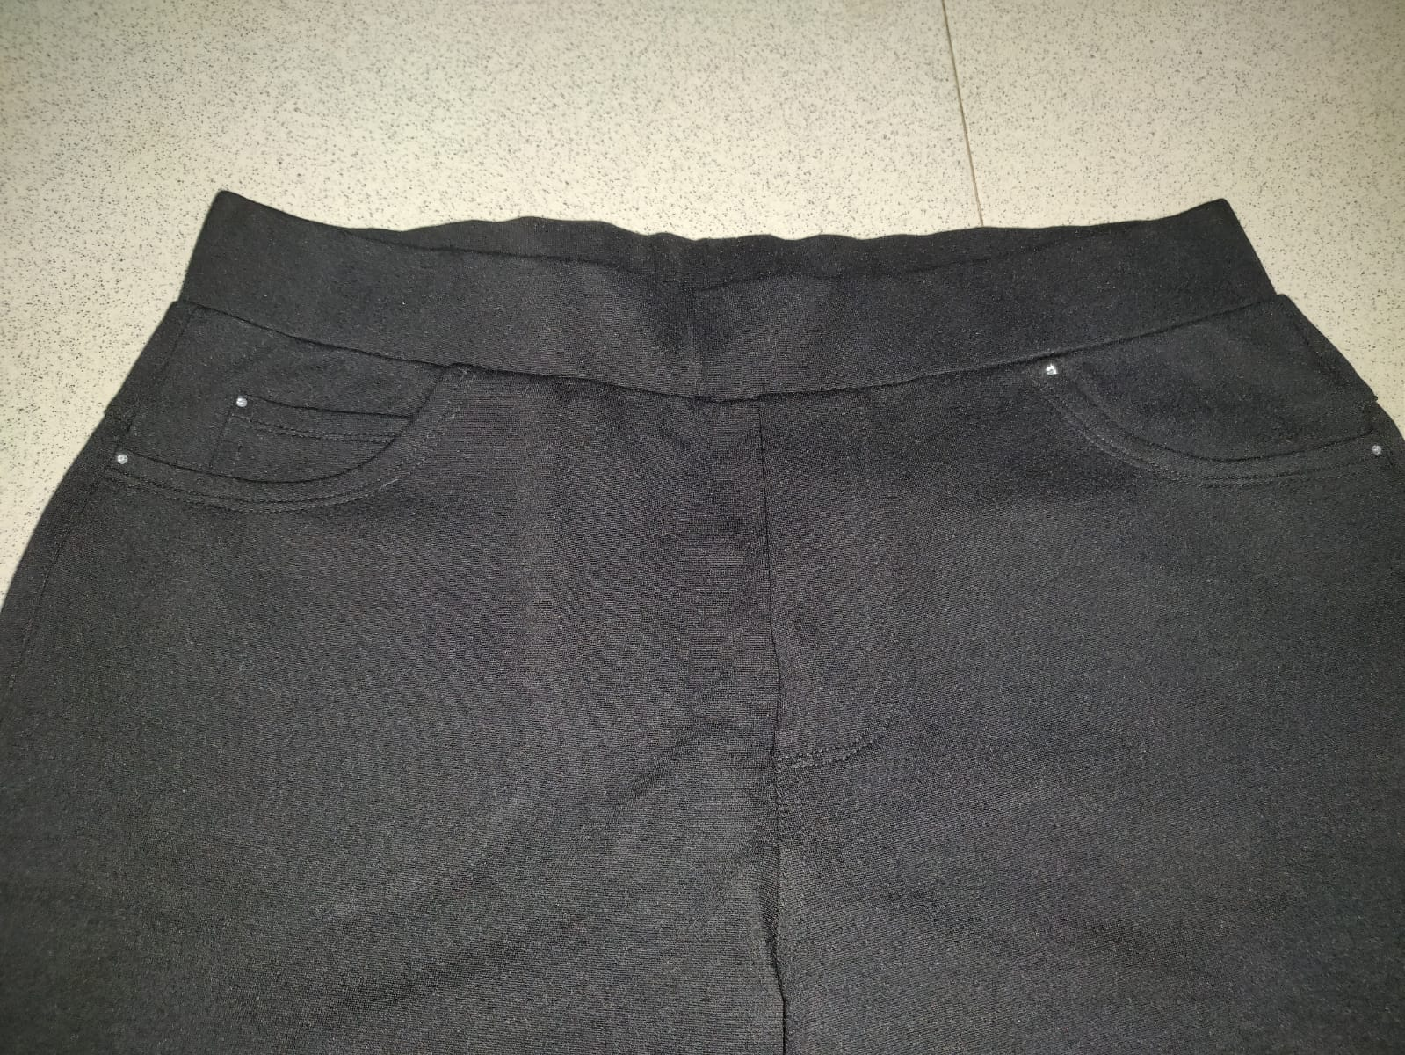
WOMENS BOTTOMS
Style number | KE-019
Product Description | Printed jeggings
Fabric Details | 95% polyester 5% spandex
Style number | KE-020
Product Description | Solid jeggings
Fabric Details | 95% polyester 5% spandex
Comments : Styles can be converted into capris too

Slide 15
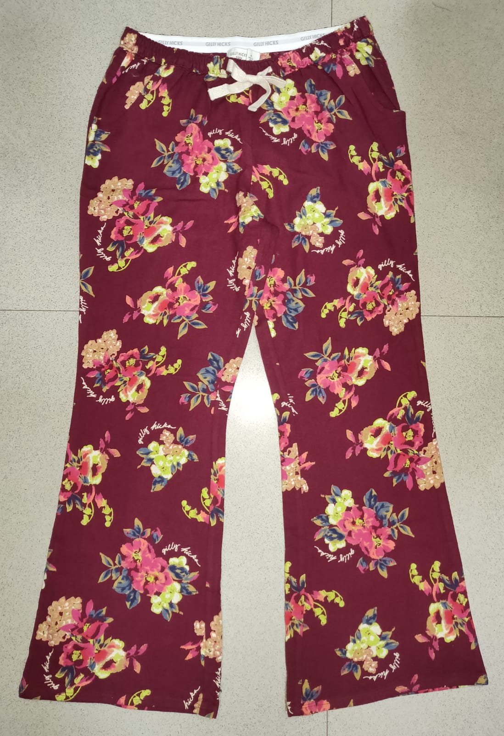
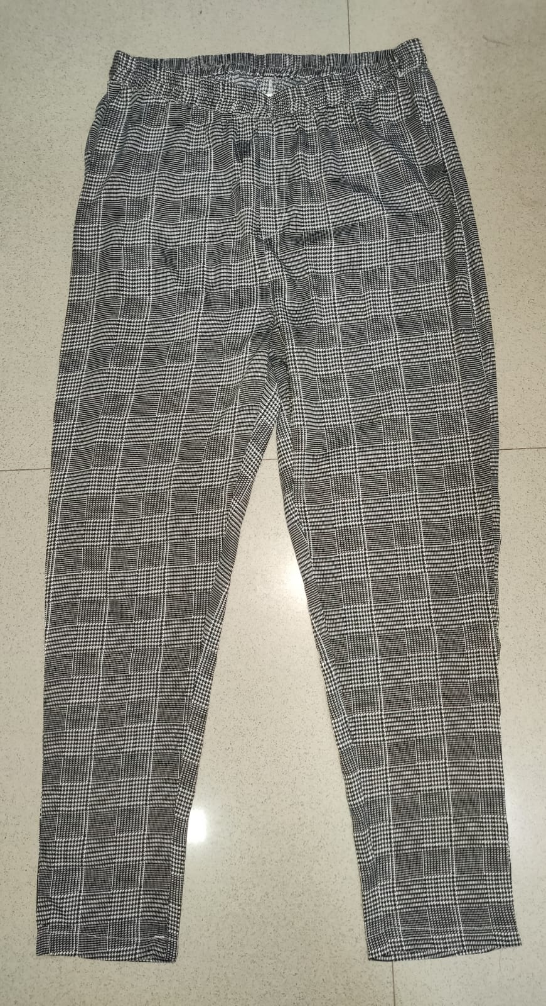
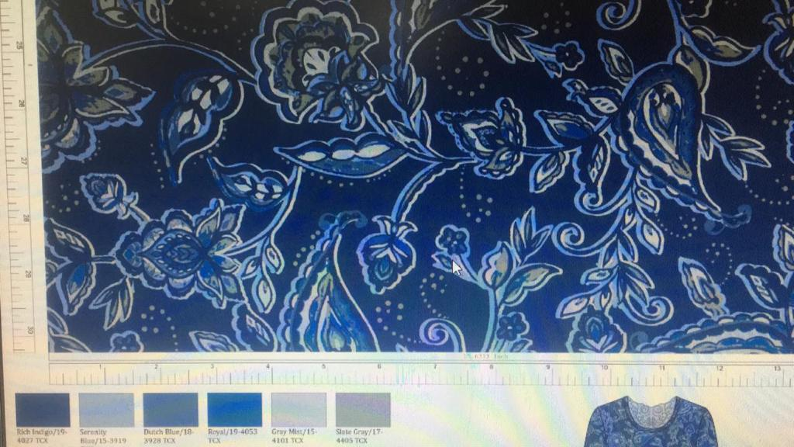
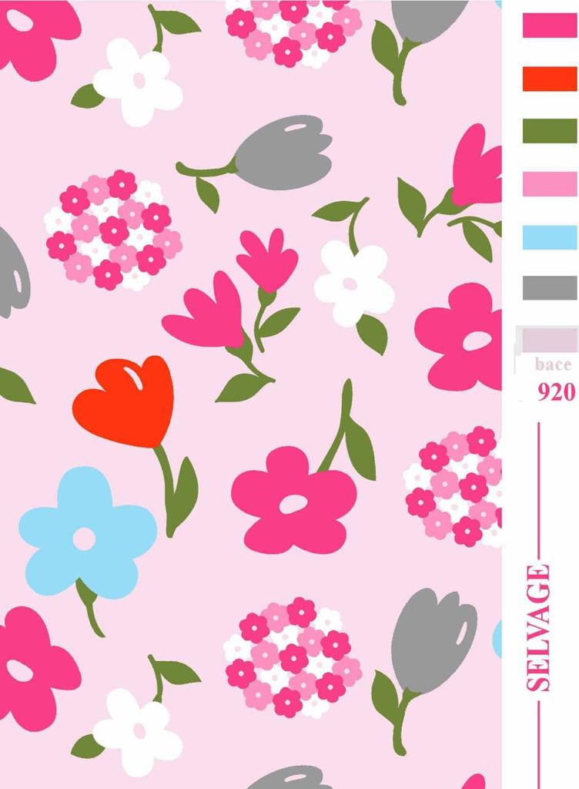
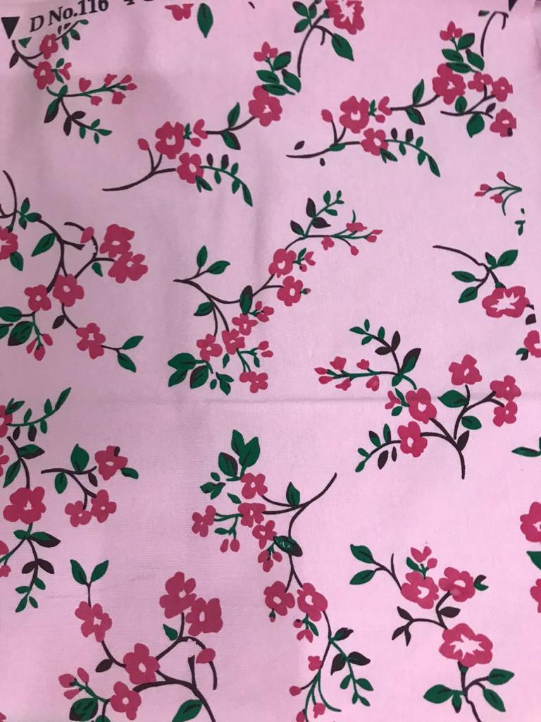
WOMENS PAJAMAS
Style number | KE-020
Product Description | Flared pajama
Fabric Details | 65% cotton 35% polyester s/j 140 GSM
Style number | KE-021
Product Description | Straight pajama
Fabric Details | 100% polyester
Comments : Styles can be converted into capris too

Slide 16
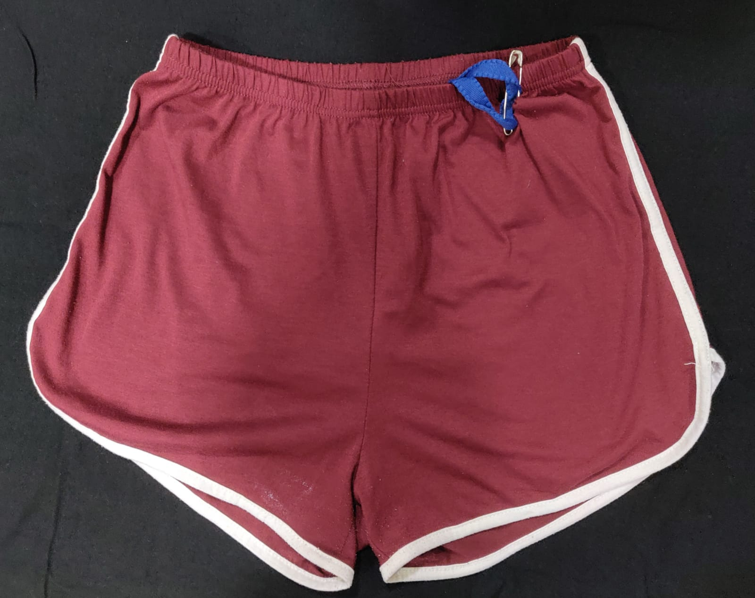
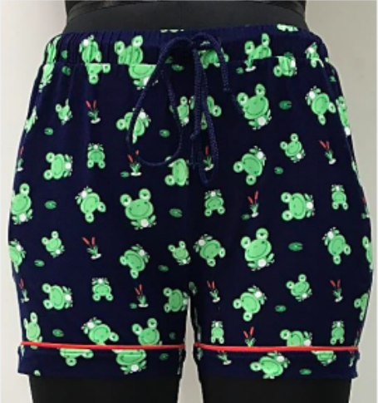
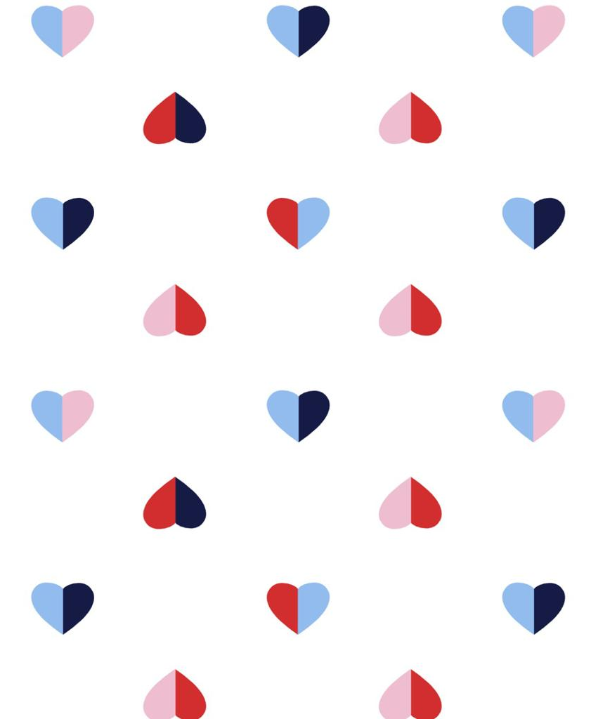
WOMENS SHORTS
Style number | KE-022
Product Description | Knit shorts
Fabric Details | 65% cotton 35% polyester s/j 140 GSM
Style number | KE-023
Product Description | Woven shorts
Fabric Details | 100% viscose

Slide 17
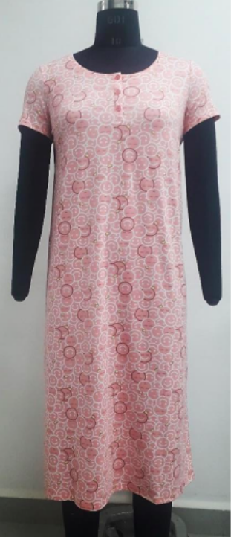
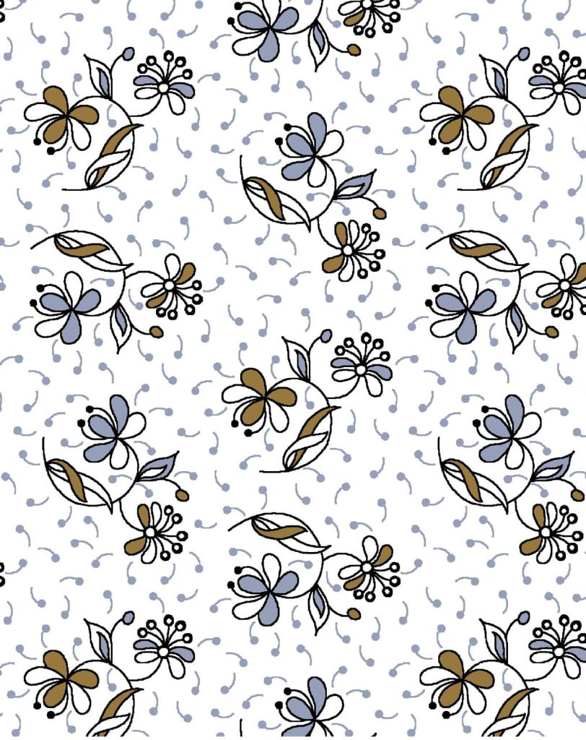
WOMENS NIGHTY
Style number | KE-024
Product Description | Knit nighty
Fabric Details | 65% cotton 35% polyester s/j 140 GSM

Slide 18
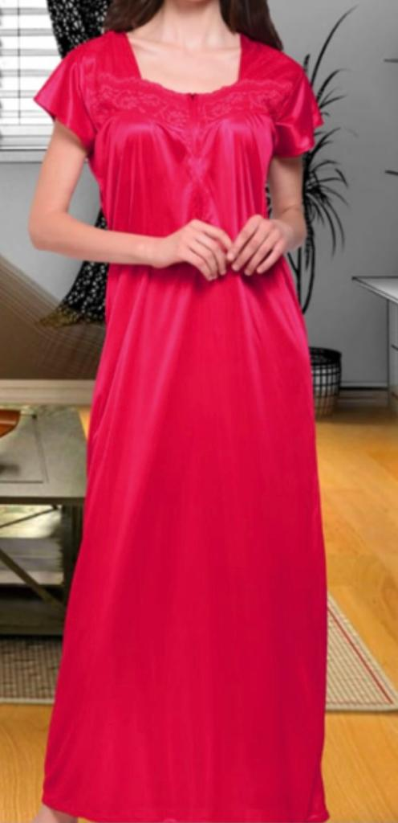
WOMENS NIGHTY
Style number | KE-025
Product Description | Full length nighty
Fabric Details | 100% polyester satin 140 GSM

