Slide 1
KRISHKAM EXPORTS MENSWEAR
TOPS & BOTTOMS

Slide 2
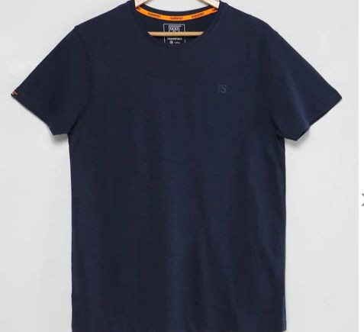
MENS T-SHIRT
Style number | KE-029
Product Description | Mens crew neck
Fabric Details | 65% cotton 35% polyester 160 GSM

Slide 3
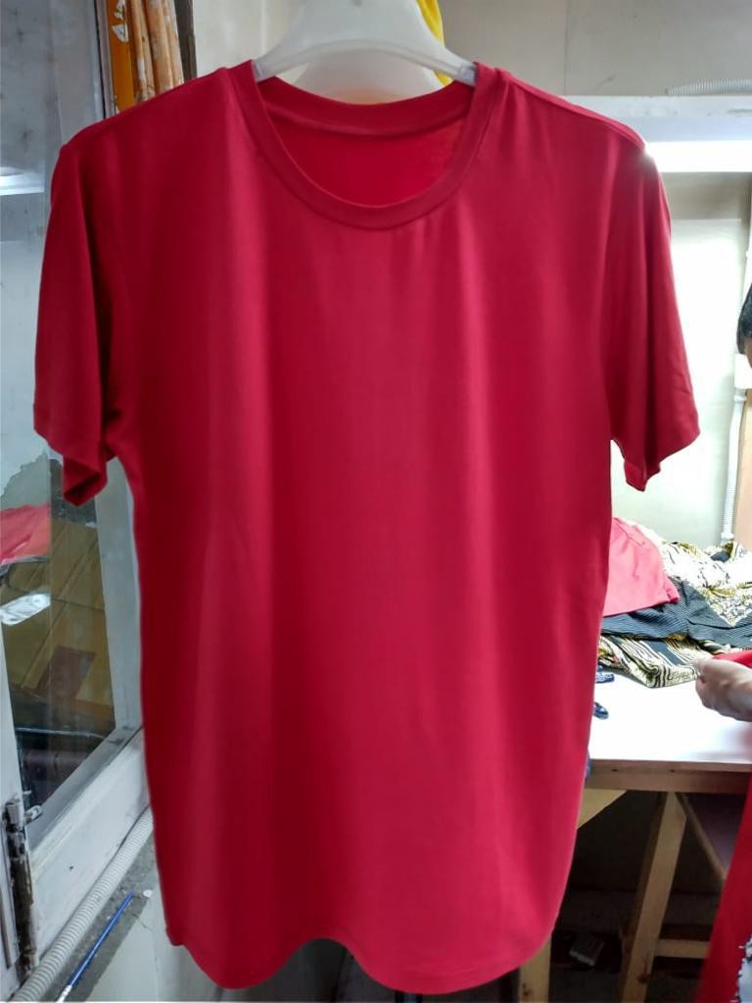
MENS T-SHIRT
Style number | KE-030
Product Description | Activewear tee
Fabric Details | 100% polyester 70 GSM

Slide 4
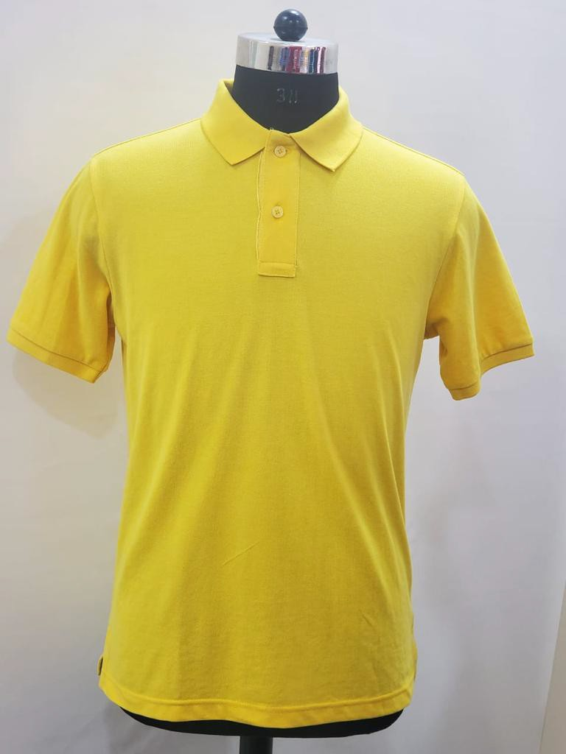
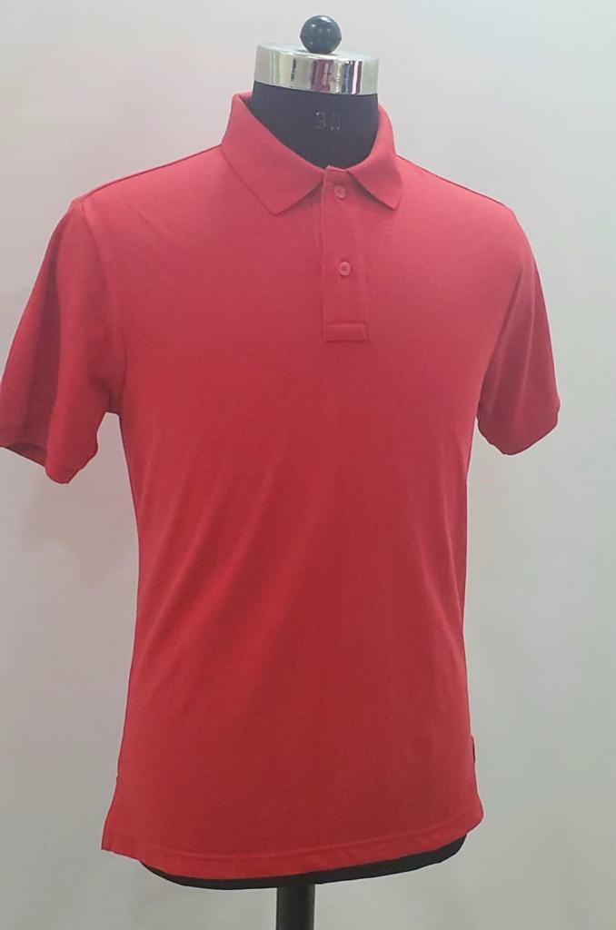
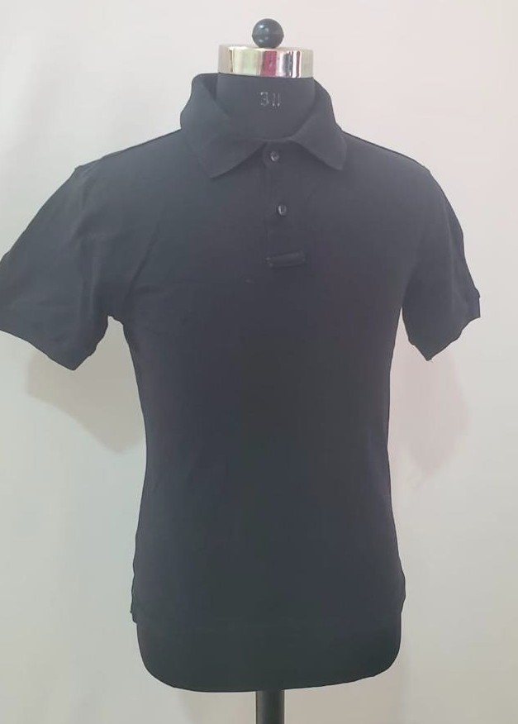
MENS POLO
 | Style number | KE-031
 | Product Description | Mens Polo
 | Fabric Details | 70% cotton 30% polyester 180 GSM

Slide 5
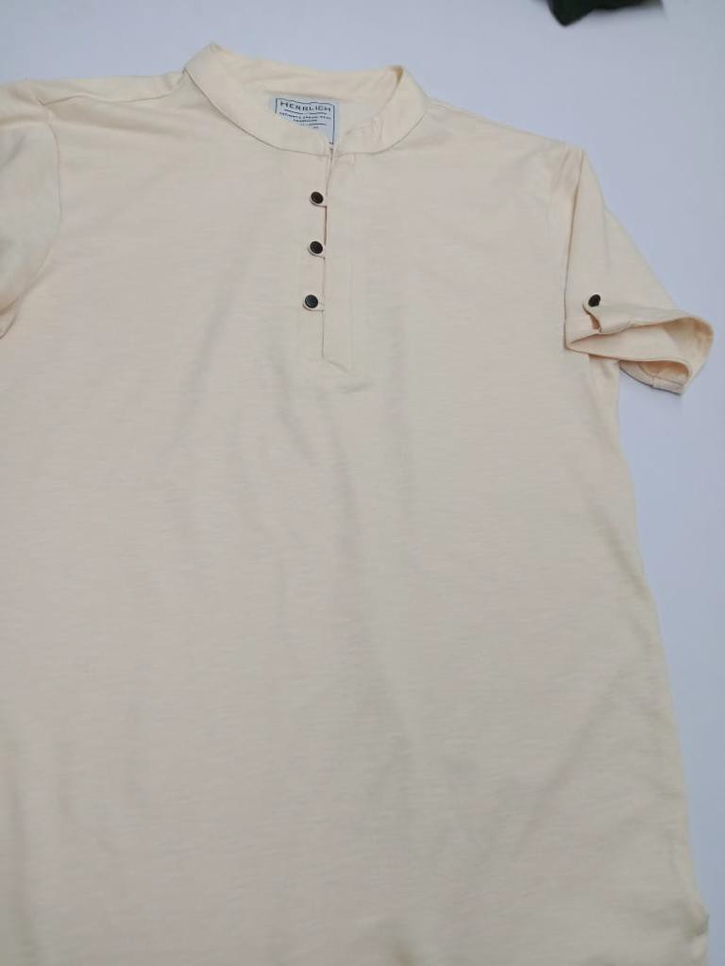
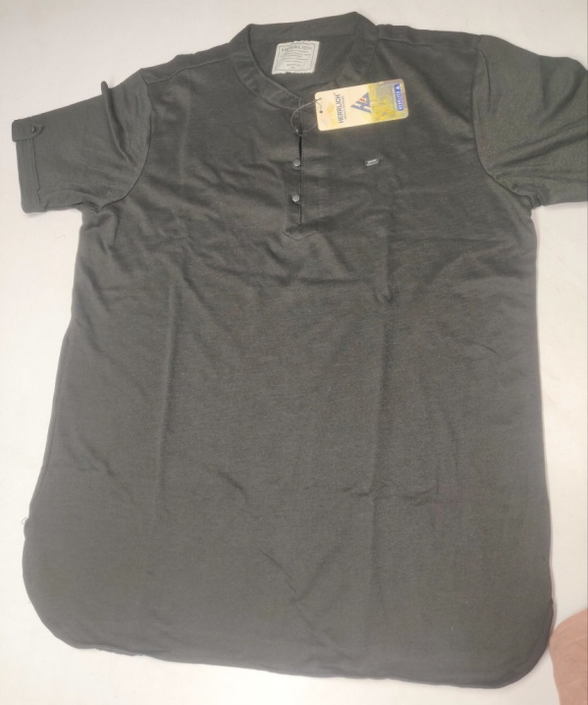
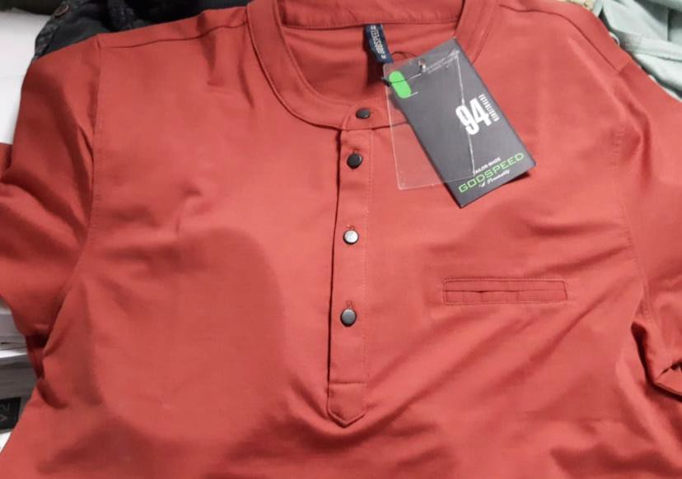
MENS HENLEY
Style number | KE-032
Product Description | Mens henley
Fabric Details | 65% polyester 35% cotton 160 GSM

Slide 6
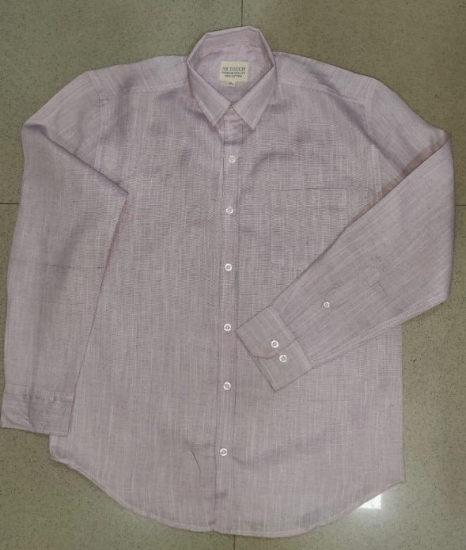
MENS SHIRT
Style number | KE-033
Product Description | L/S shirt
Fabric Details | 100% cotton 120 GSM

Slide 7
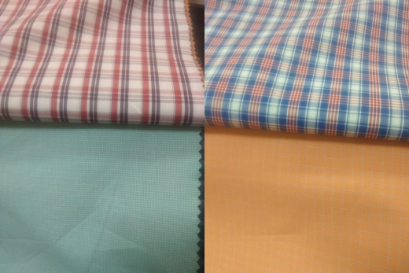
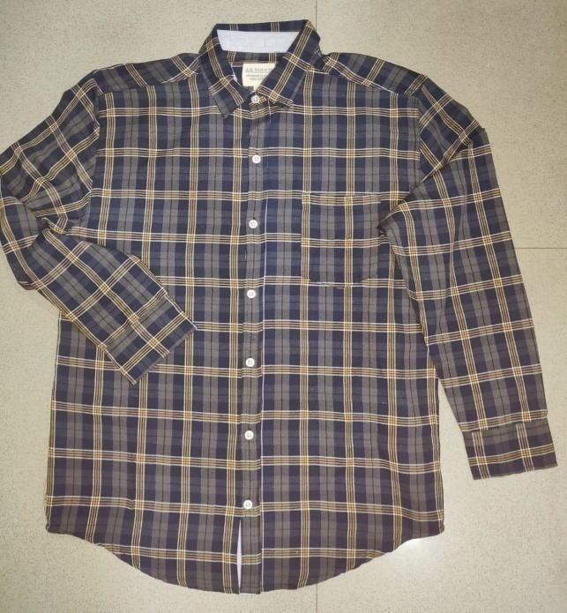
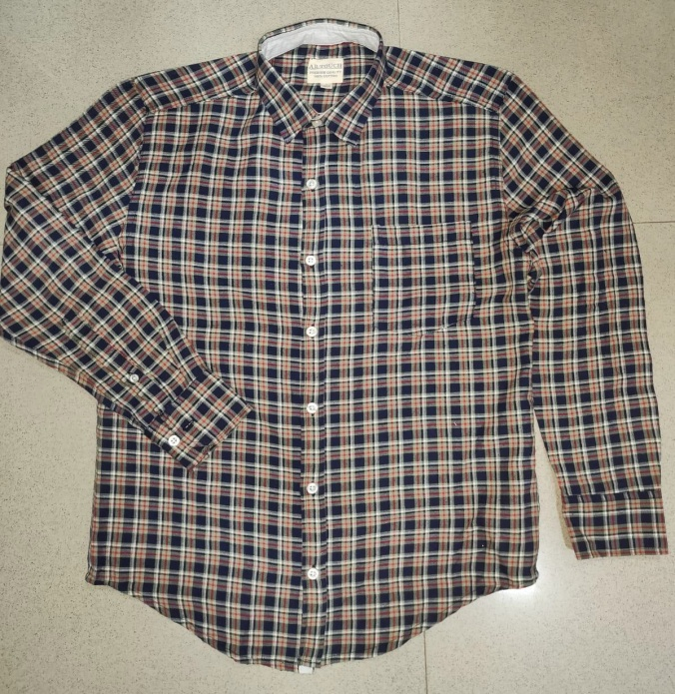
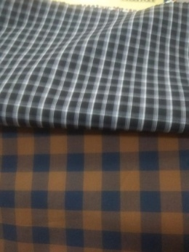
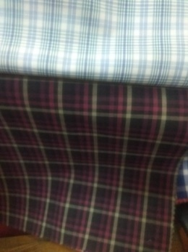
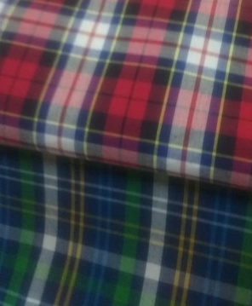
MENS SHIRT
Style number | KE-034
Product Description | L/S shirt
Fabric Details | 100% cotton 30s 92x64 / 120 GSM

Slide 8
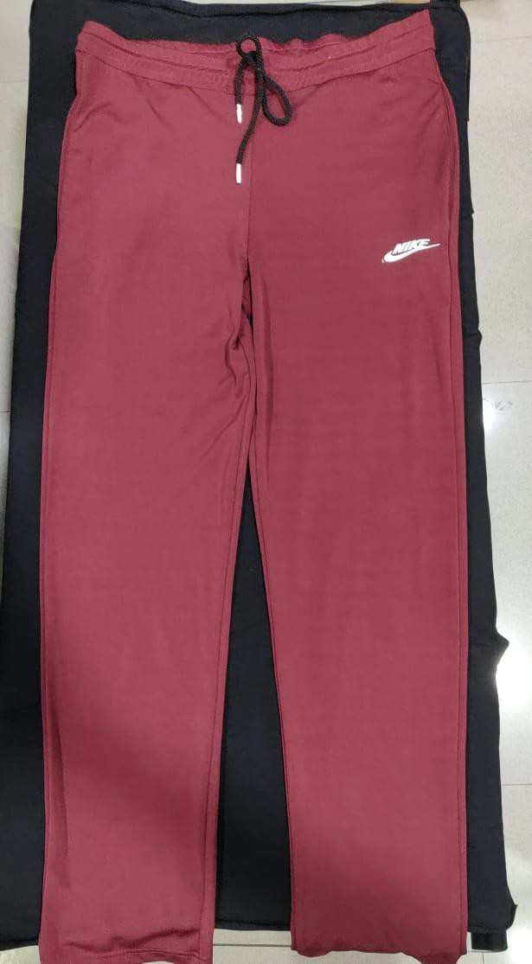
MENS BOTTOMS
Style number | KE-035
Product Description | Activewear tracks
Fabric Details | 100% polyester 180 GSM

Slide 9
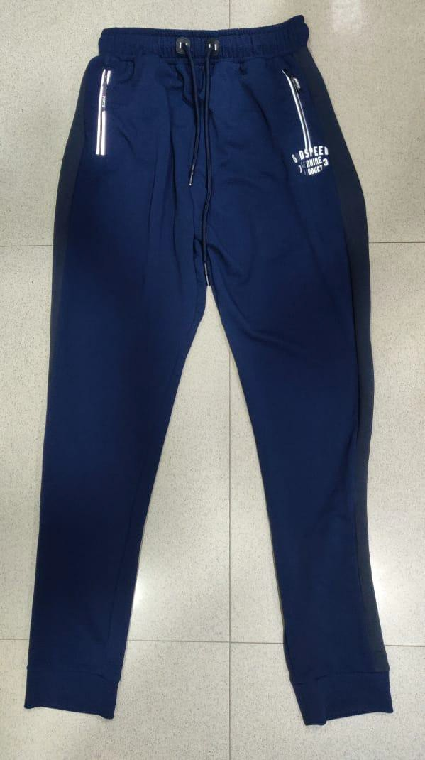
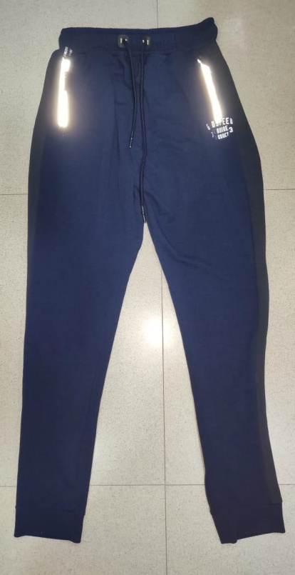
MENS BOTTOMS
Style number | KE-036
Product Description | Textured knit jogger
Fabric Details | 100% polyester 200 GSM

Slide 10
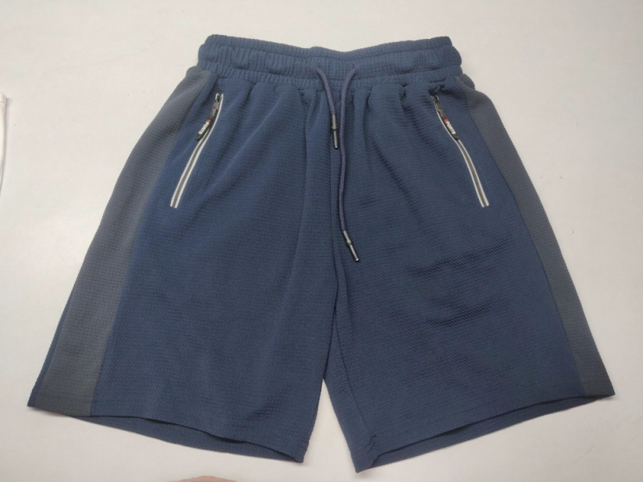
MENS BOTTOMS
Style number | KE-037
Product Description | Textured knit shorts
Fabric Details | 100% polyester 200 GSM

Slide 11
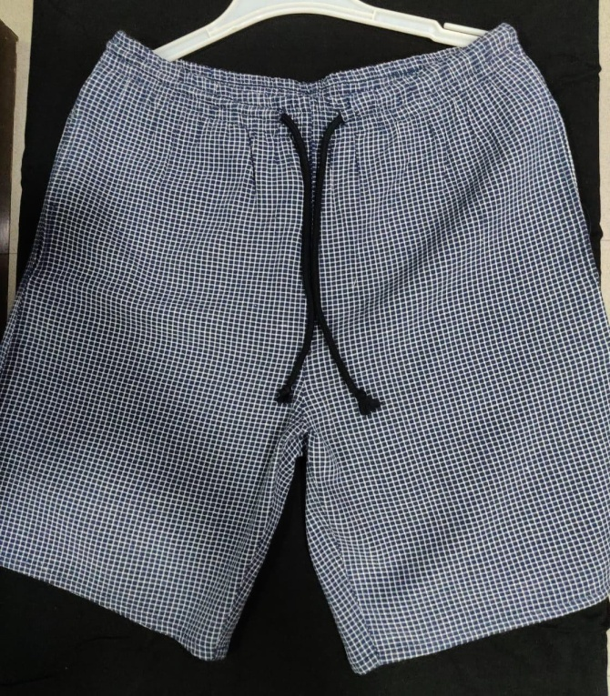
MENS SHORTS
Style number | KE-038
Product Description | Woven shorts
Fabric Details | 100% cotton 120 GSM

Slide 12
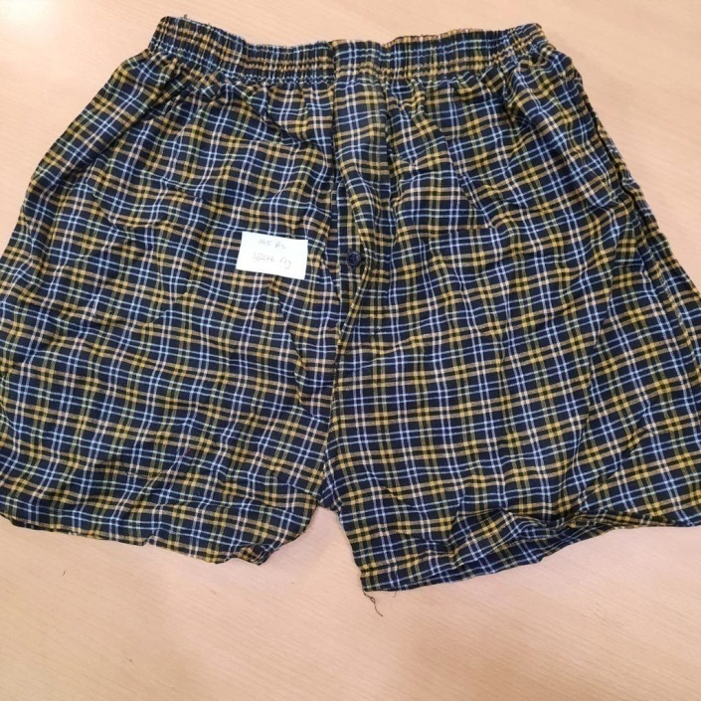
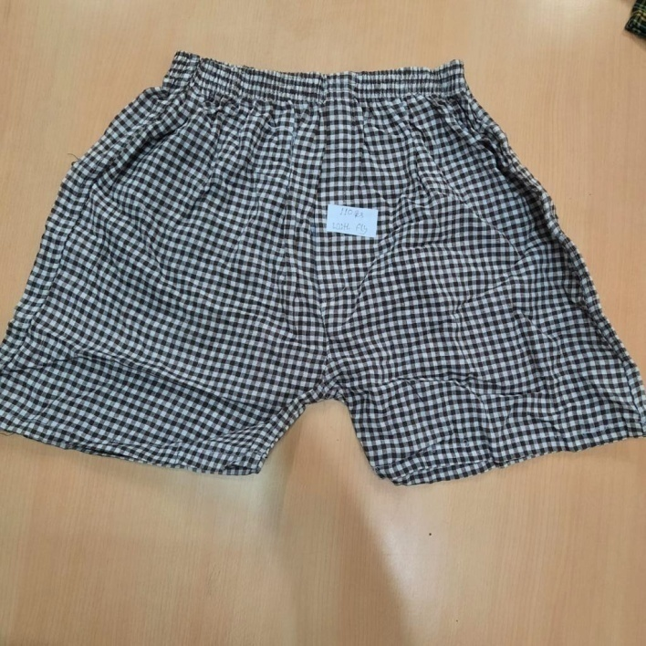
MENS BOXERS
Style number | KE-039
Product Description | Checks boxers
Fabric Details | 100% cotton 110 GSM

Slide 13
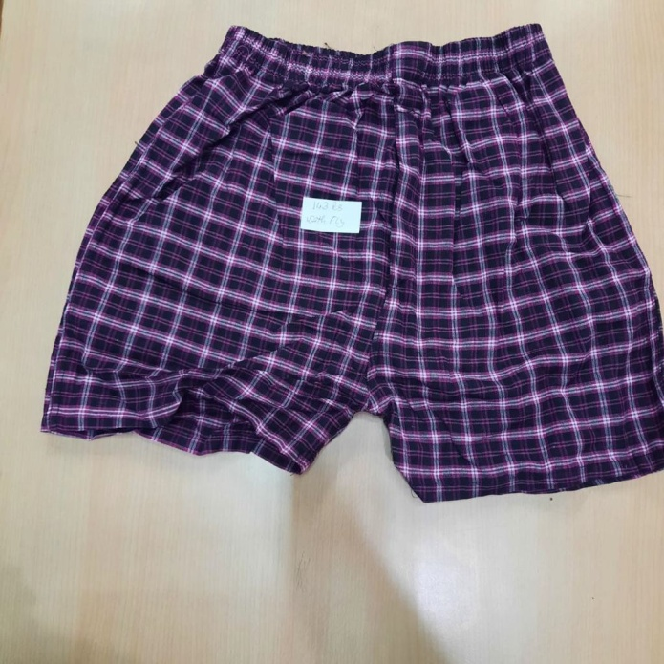
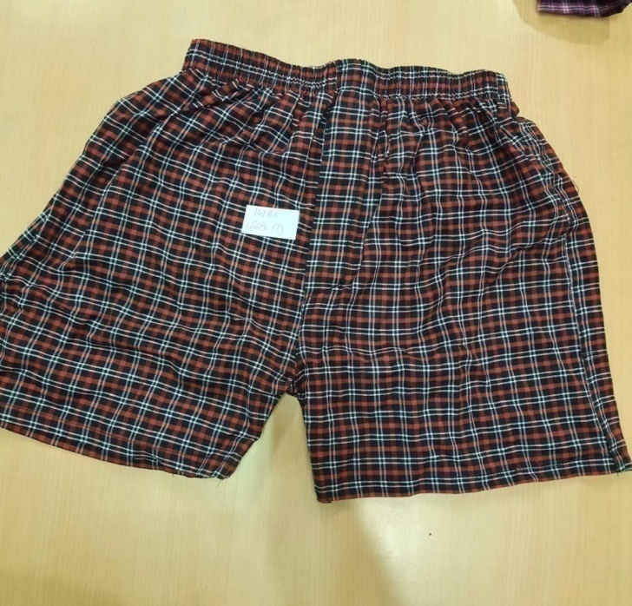
MENS BOXERS
Style number | KE-039
Product Description | Checks boxers
Fabric Details | 100% cotton 110 GSM

Slide 14
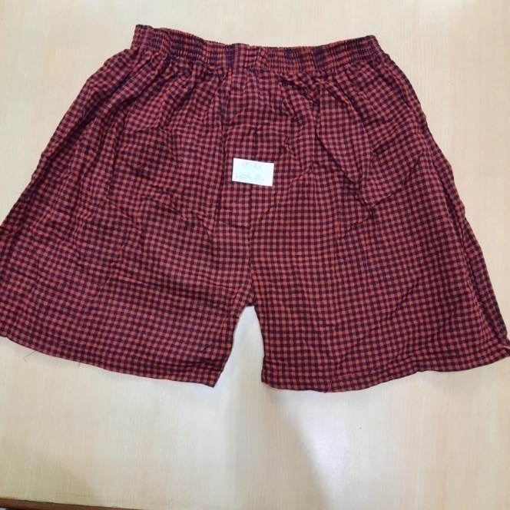
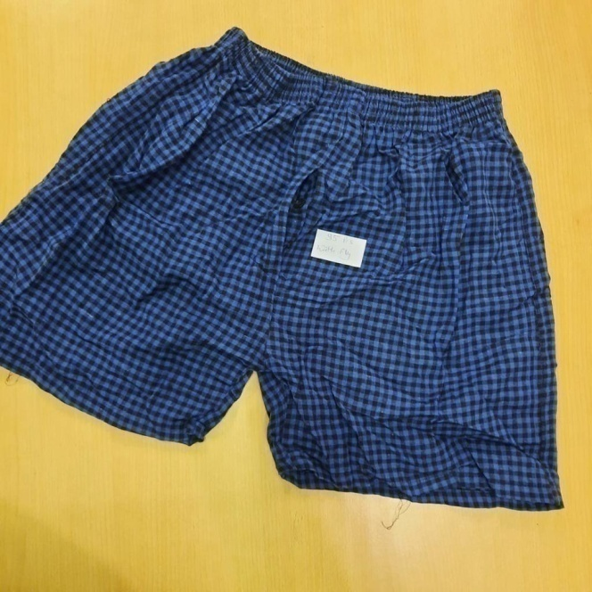
MENS BOXERS
Style number | KE-039
Product Description | Checks boxers
Fabric Details | 100% cotton 110 GSM

Slide 15
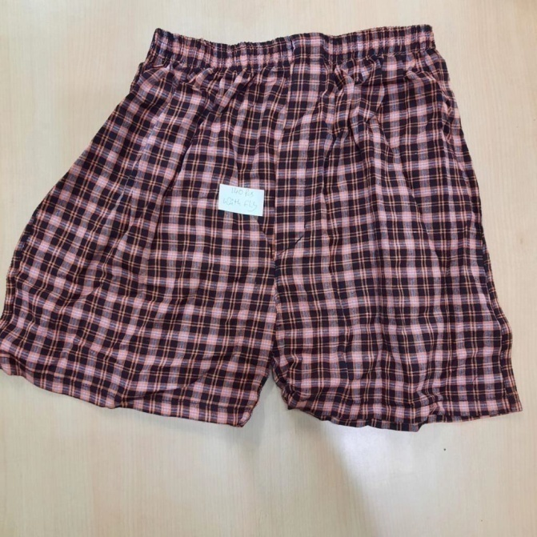
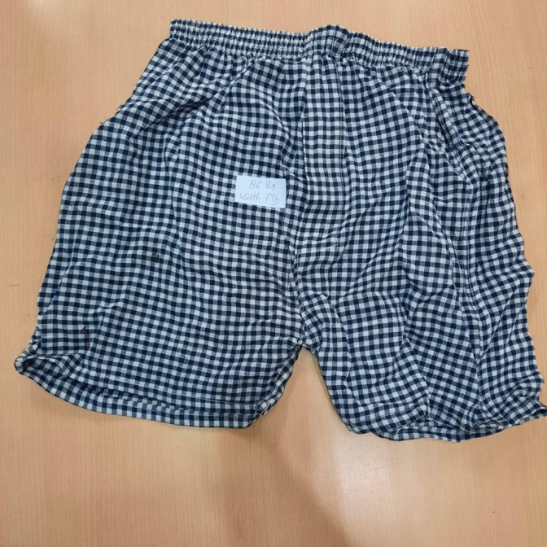
MENS BOXERS
Style number | KE-039
Product Description | Checks boxers
Fabric Details | 100% cotton 110 GSM

